Slide 1

Registration Tutorial
How to Register to BINUS Supplier Portal

Slide 2
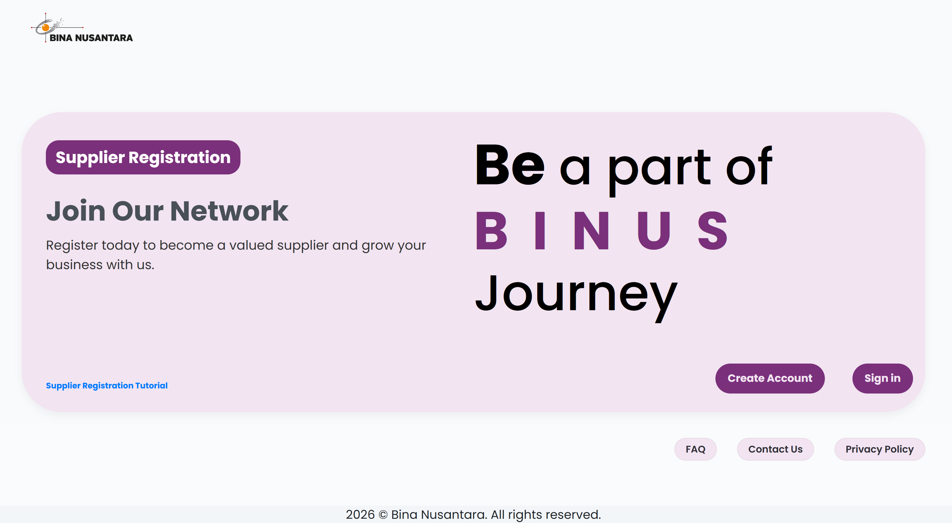
View Registration Tutorial here
Create Account
(if you don’t have account)
Sign In
Information

Slide 3
Simple Step to Register your account :
Create Account
Verification
Complete Registration

Slide 4
Create Account
Click Create Account
Make sure that
you used the active email

Slide 5
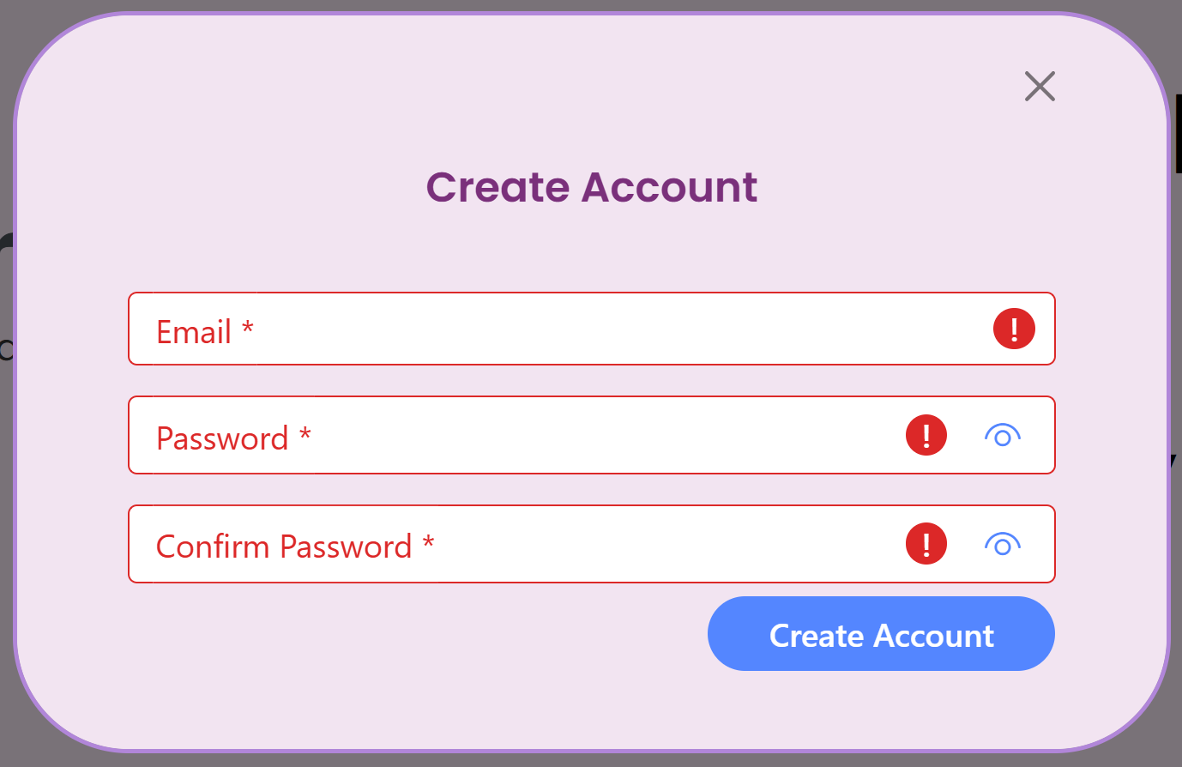
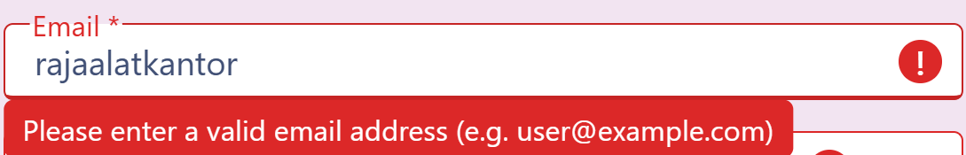
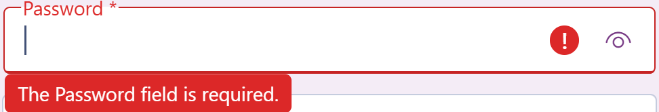
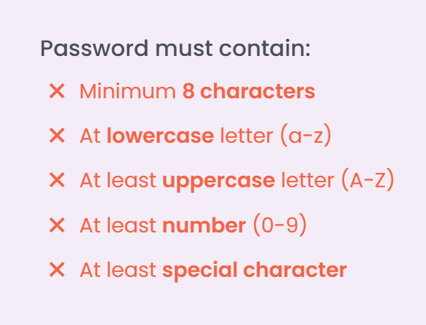
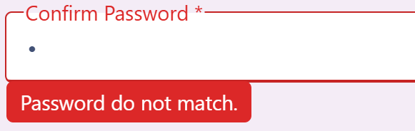
Create Account
1
Make sure you used an active email account, that has not been used for registration before
2
Email is required, please fill it with full email format
3
Password is required and follow some requirement
4

Slide 6
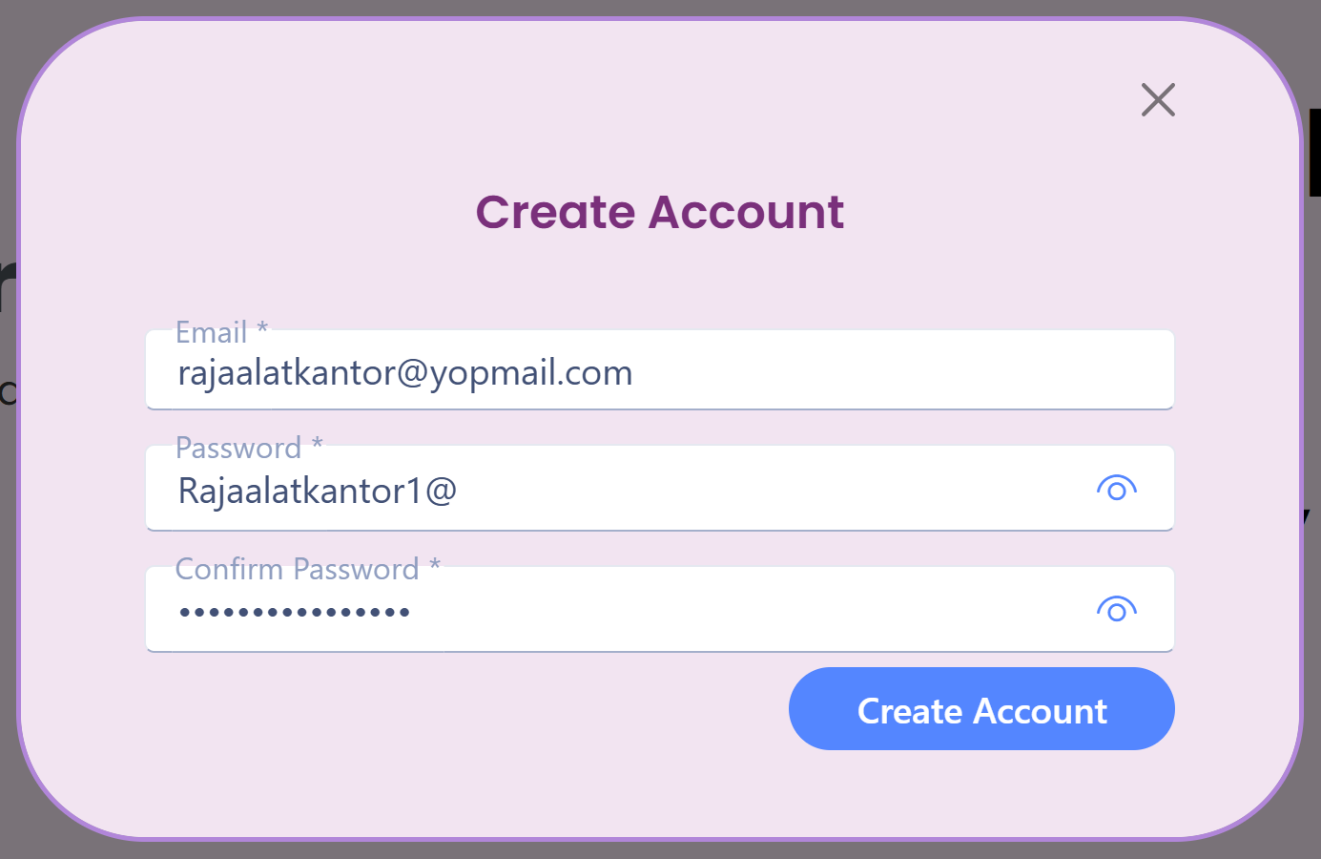
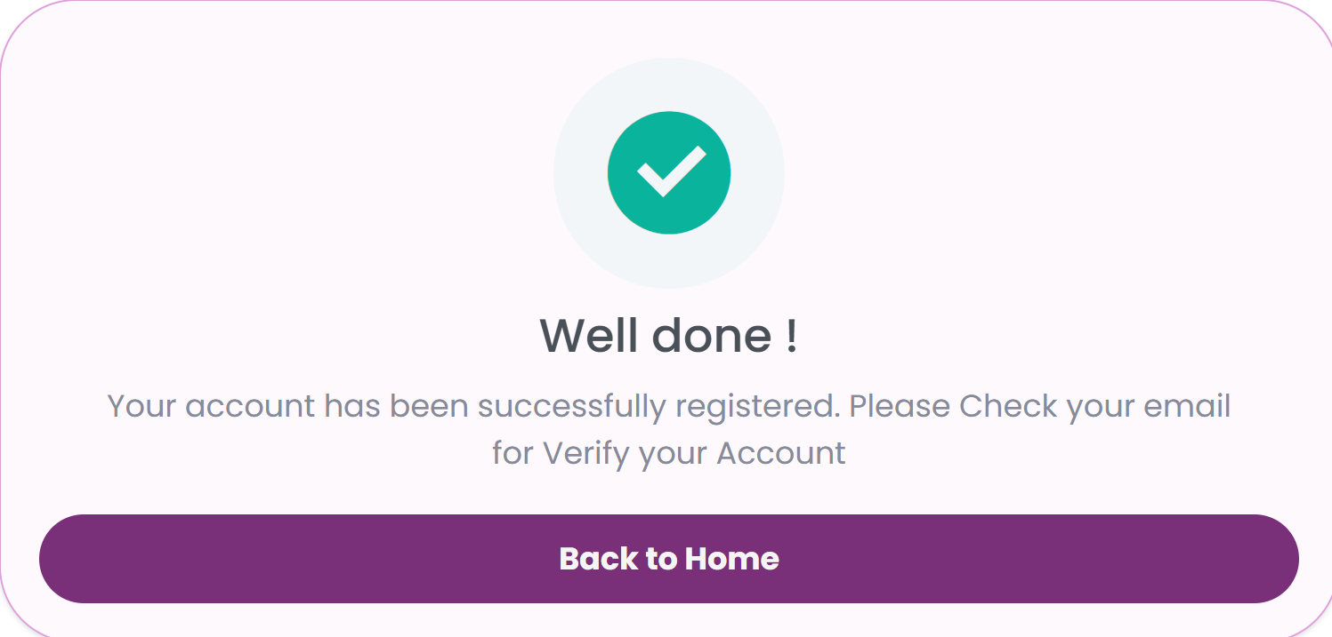

Create Account
once you successfully create account, you will need to verify your email
What you need to do :
Access your email and you will find verification email sent from noreply@procurement.binus.edu
Click verify in your email within 24 hours
Click Create Account
FAQ
What if I had an expired verification link?

Slide 7
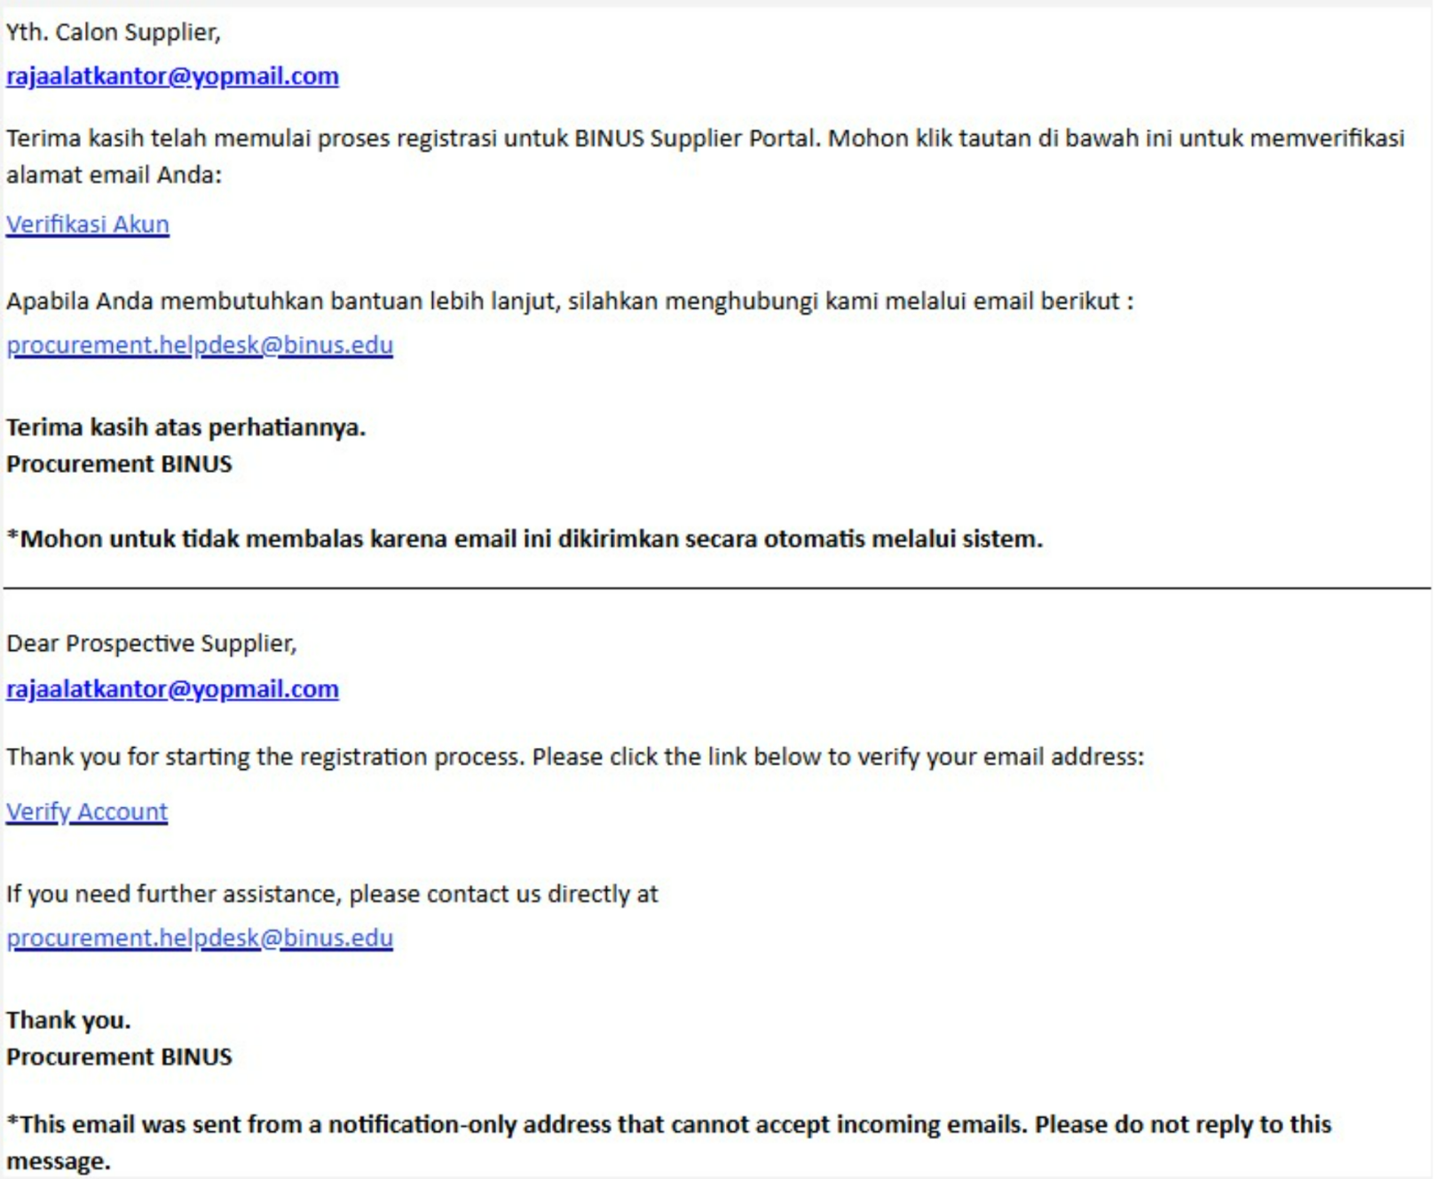
Verification
If you receive this email,
click on
Verifikasi Akun / Verify Account

Slide 8
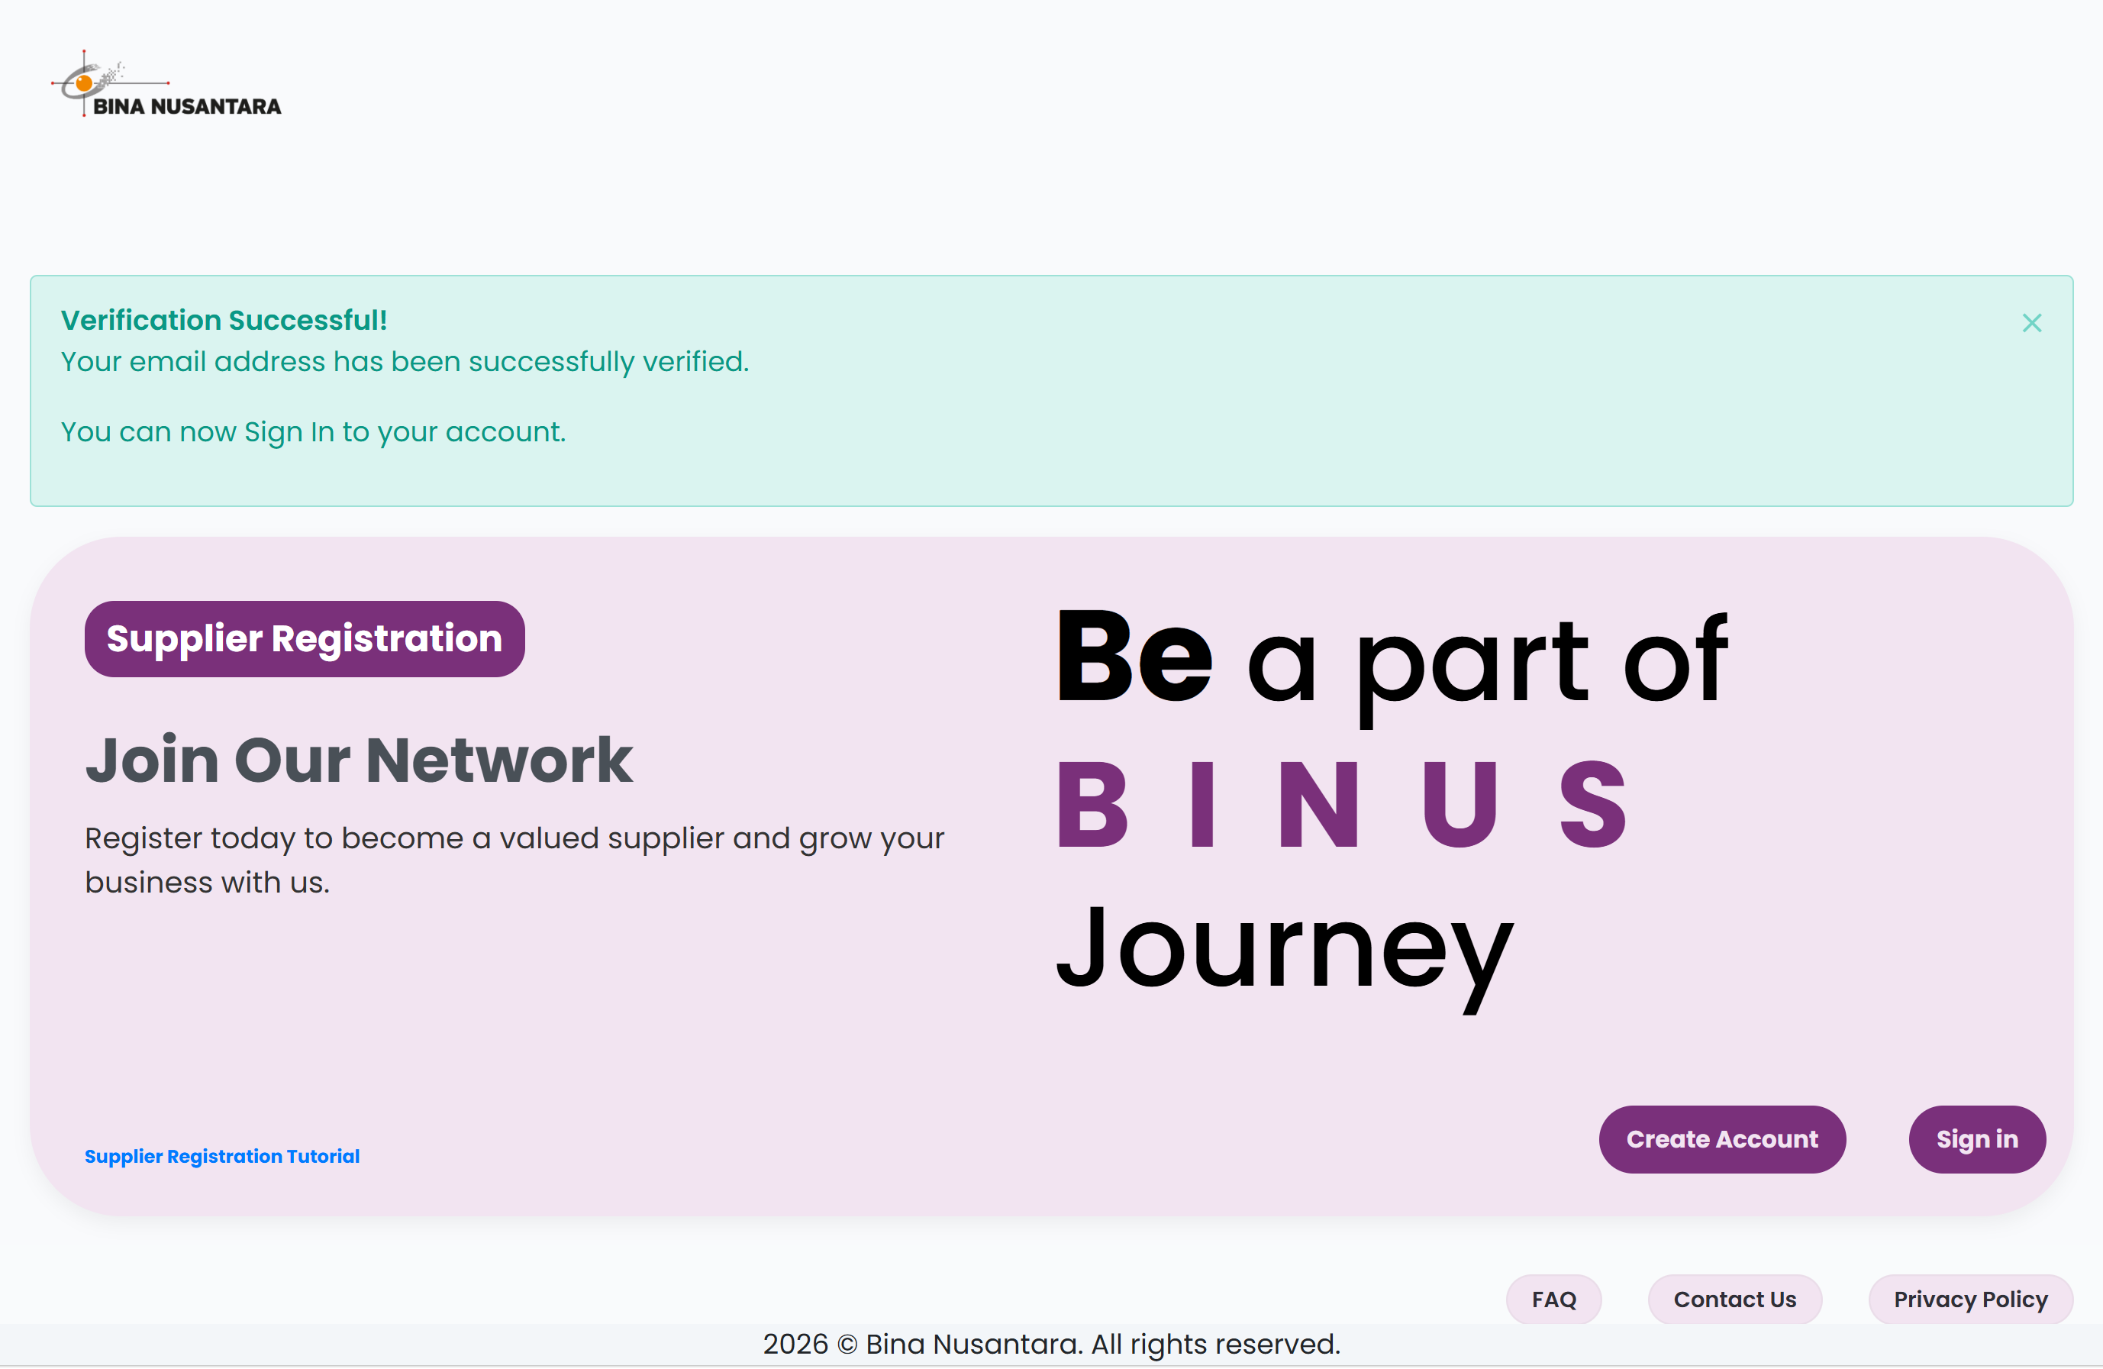
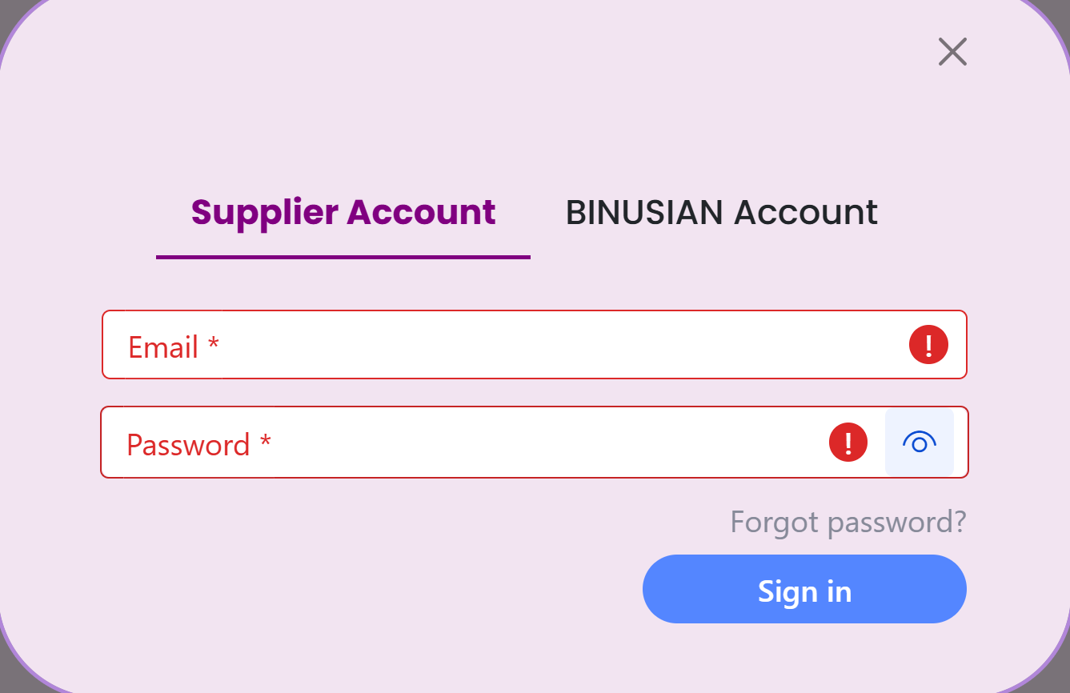
Verification
This notice is the sign that Verification has successfully done, you can now Sign In to
Complete Registration

Slide 9
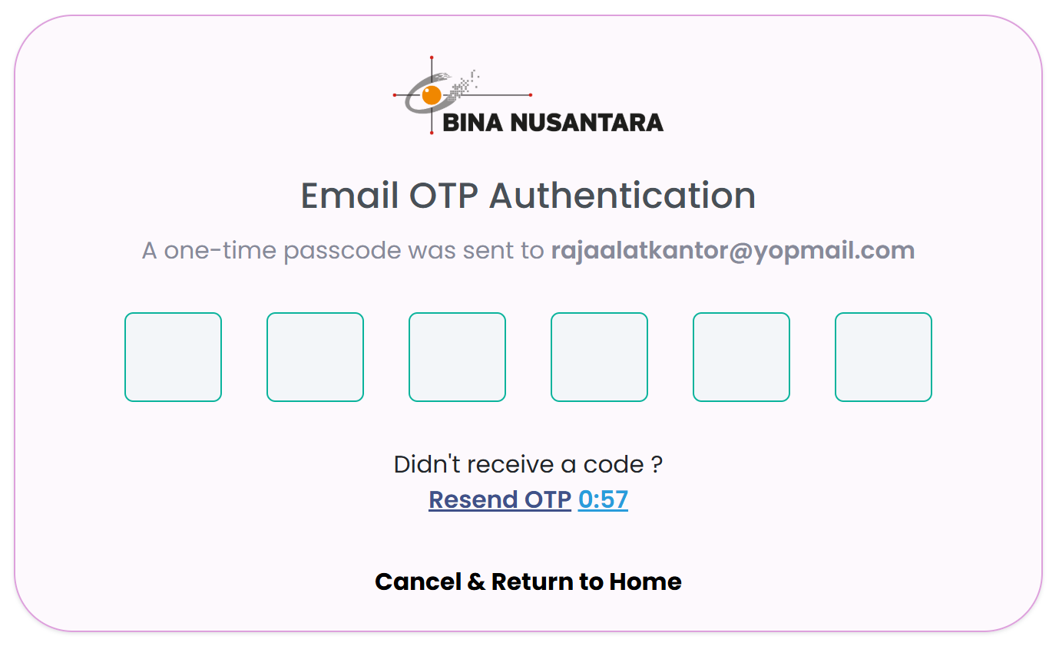
Sign In
1
Sign in will be separated to Supplier and BINUSIAN Account
Click Supplier Account
2
After you verify your email, you can log in with that corresponding email and password
3
Everytime you sign in, system will sent 6 digit OTP to your email, and you need to fill it to authentication page.
FAQ
What if you forget your password ?
What if I had failed to input OTP ?

Slide 10
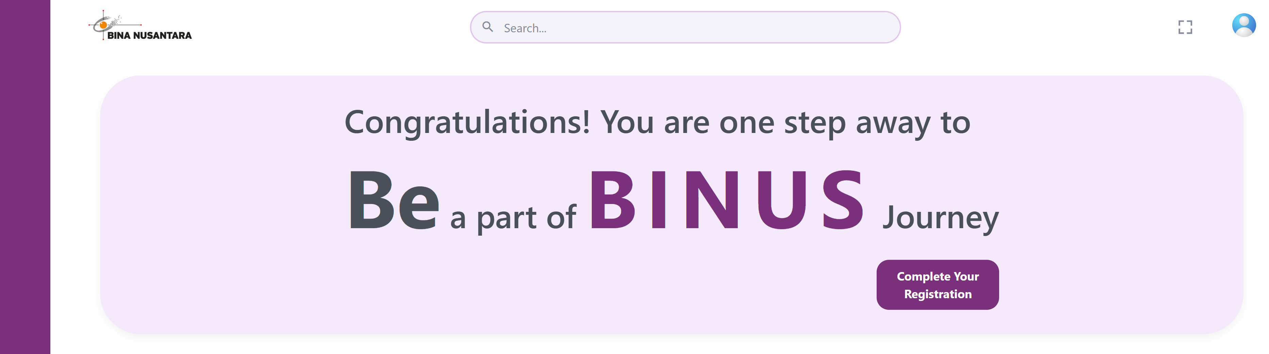
Complete Registration
Click
Complete Registration
FAQ
Is it okay to complete registration later ?
What should I prepared before register ?

Slide 11
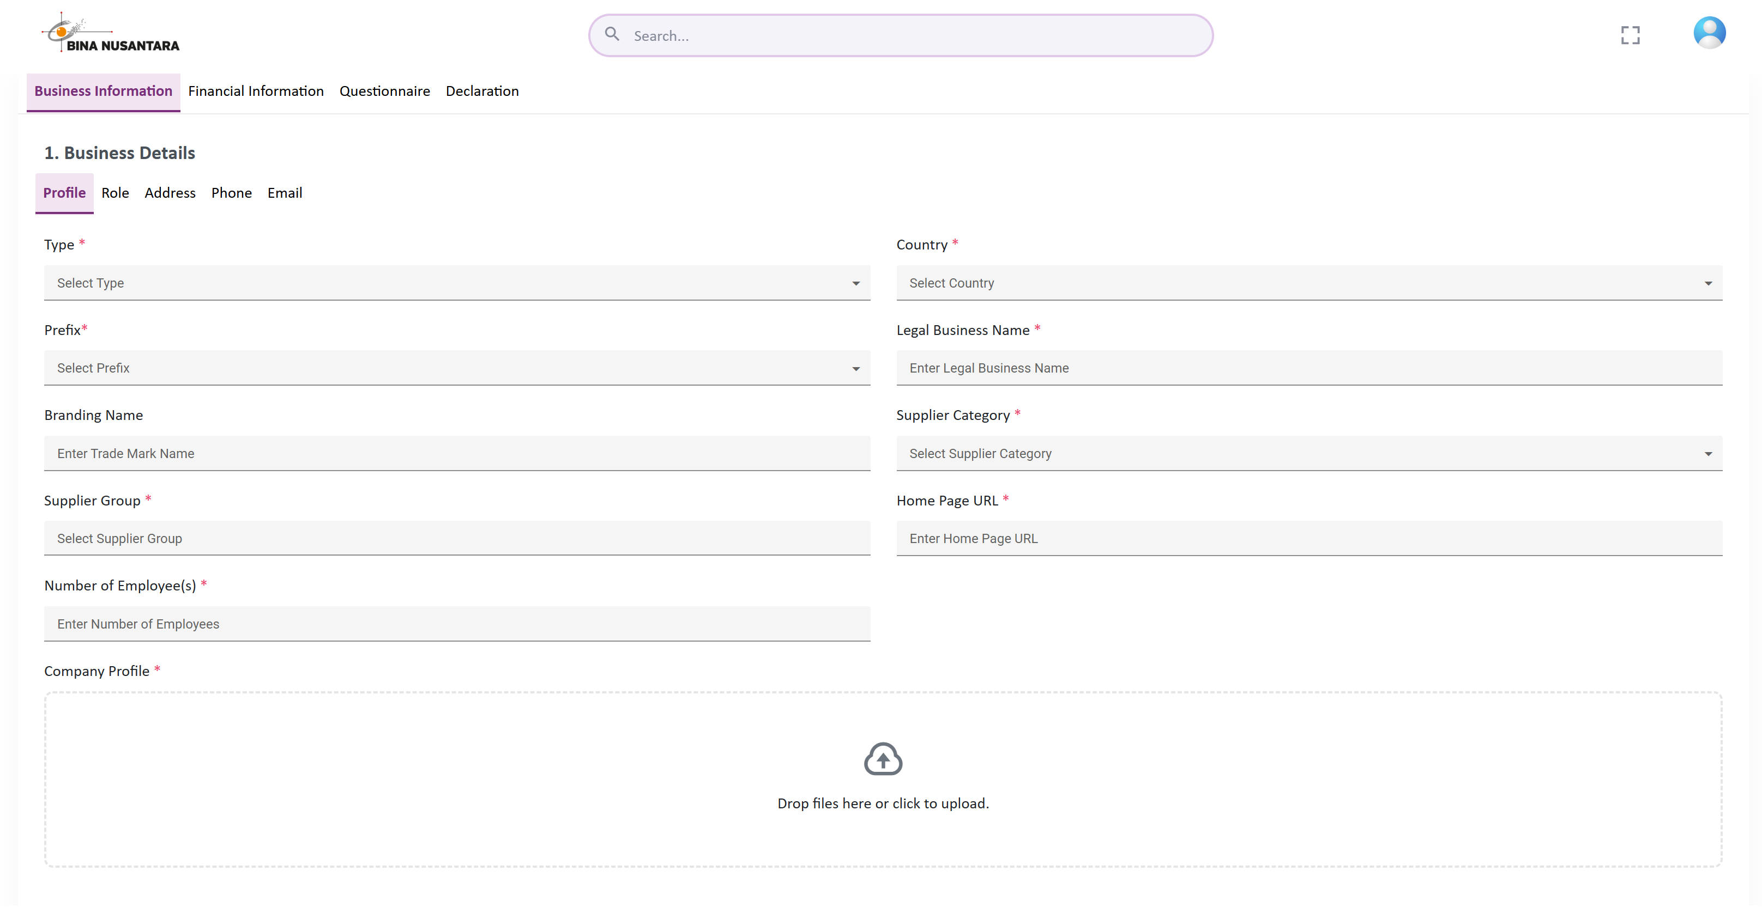
Complete Registration
4 Segment that must be filled :
Business Information
Financial Information
Questionnaire
Declaration

Slide 12
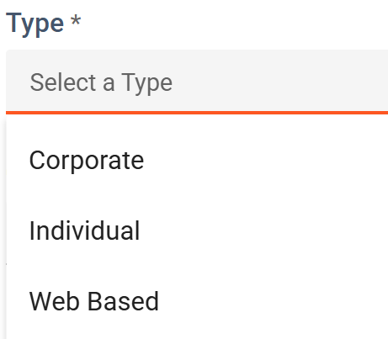
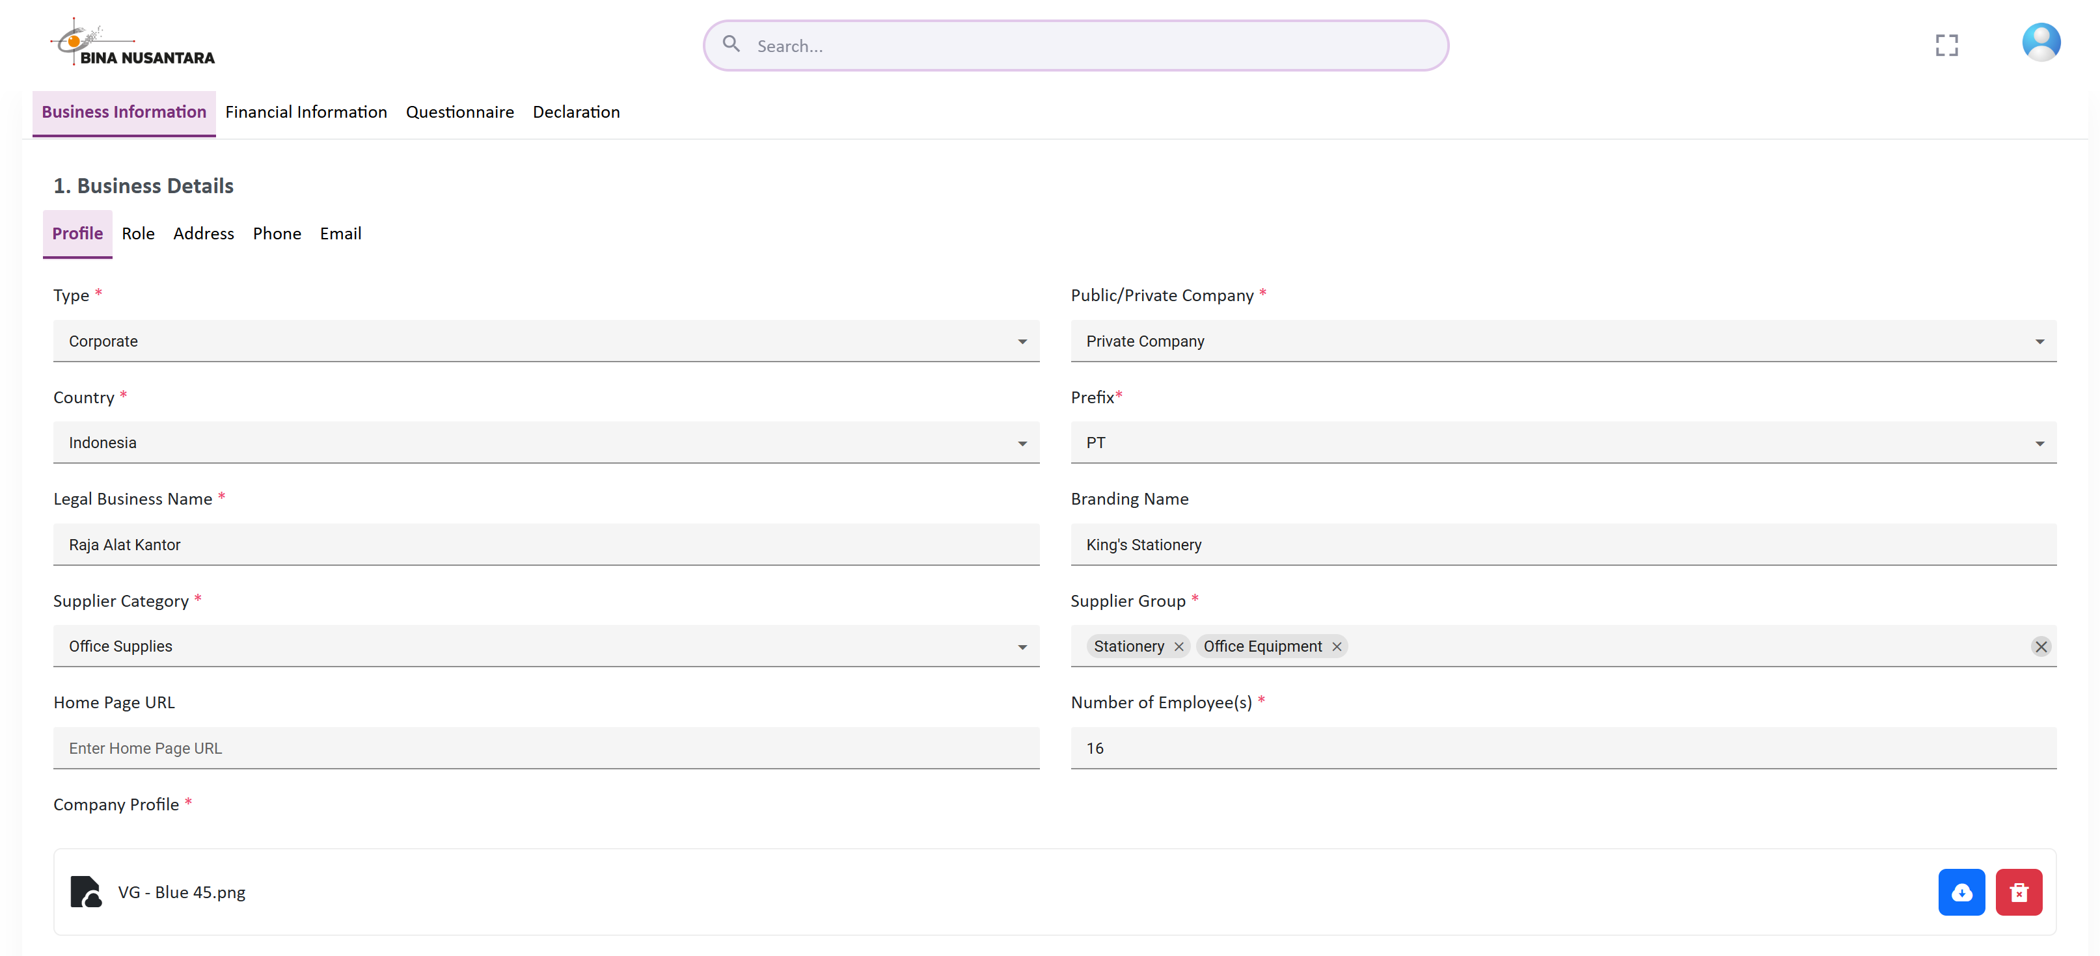
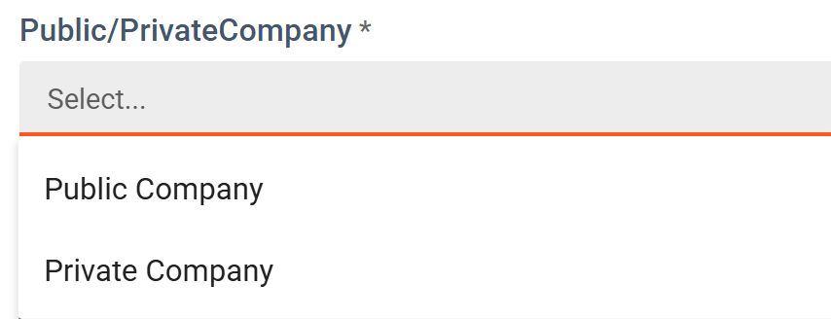
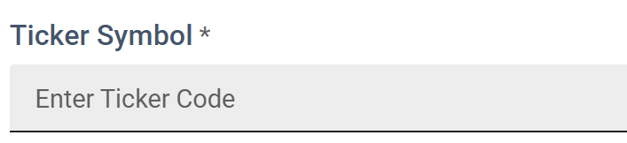
Complete Registration
Business Information - Details
1
Business Type determine some fields on form
2
4
5
Public or Private Company show if Business Type is Corporate
3
If Public Company, fill Emiten Code if any or with strip
Country
Choose your company country location
Prefix
Type of company, show based on country chosen

Slide 13
Complete Registration
Business Information - Details
Legal Business Name
Must match official legal documents (based on NIB / Business Identification Number, Deed of Establishment). You don’t have to put prefix again. Example : PT Raja Alat Kantor, fill with only “Raja Alat Kantor”
1
Branding Name
Trade Name or Commercial Alias Name. Optional Field
2
3
Supplier Category
Choose one that suits your main business.
Supplier Group
Multi Supplier Group can be chosen. Supplier Group is product or services you provide. Please choose accordance with NIB and your main business specialization.

Slide 14
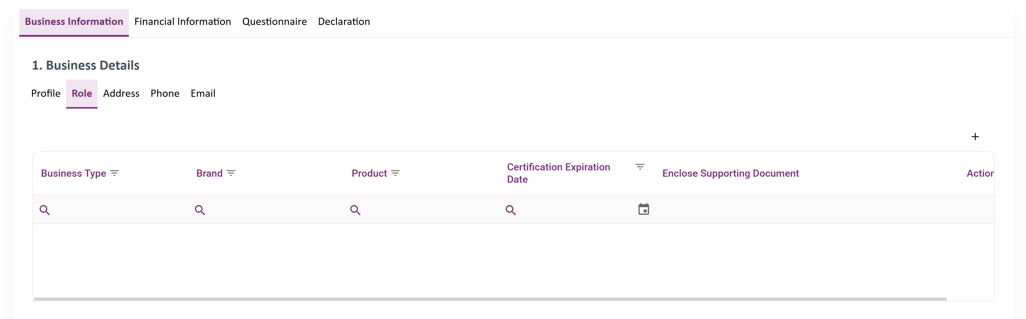
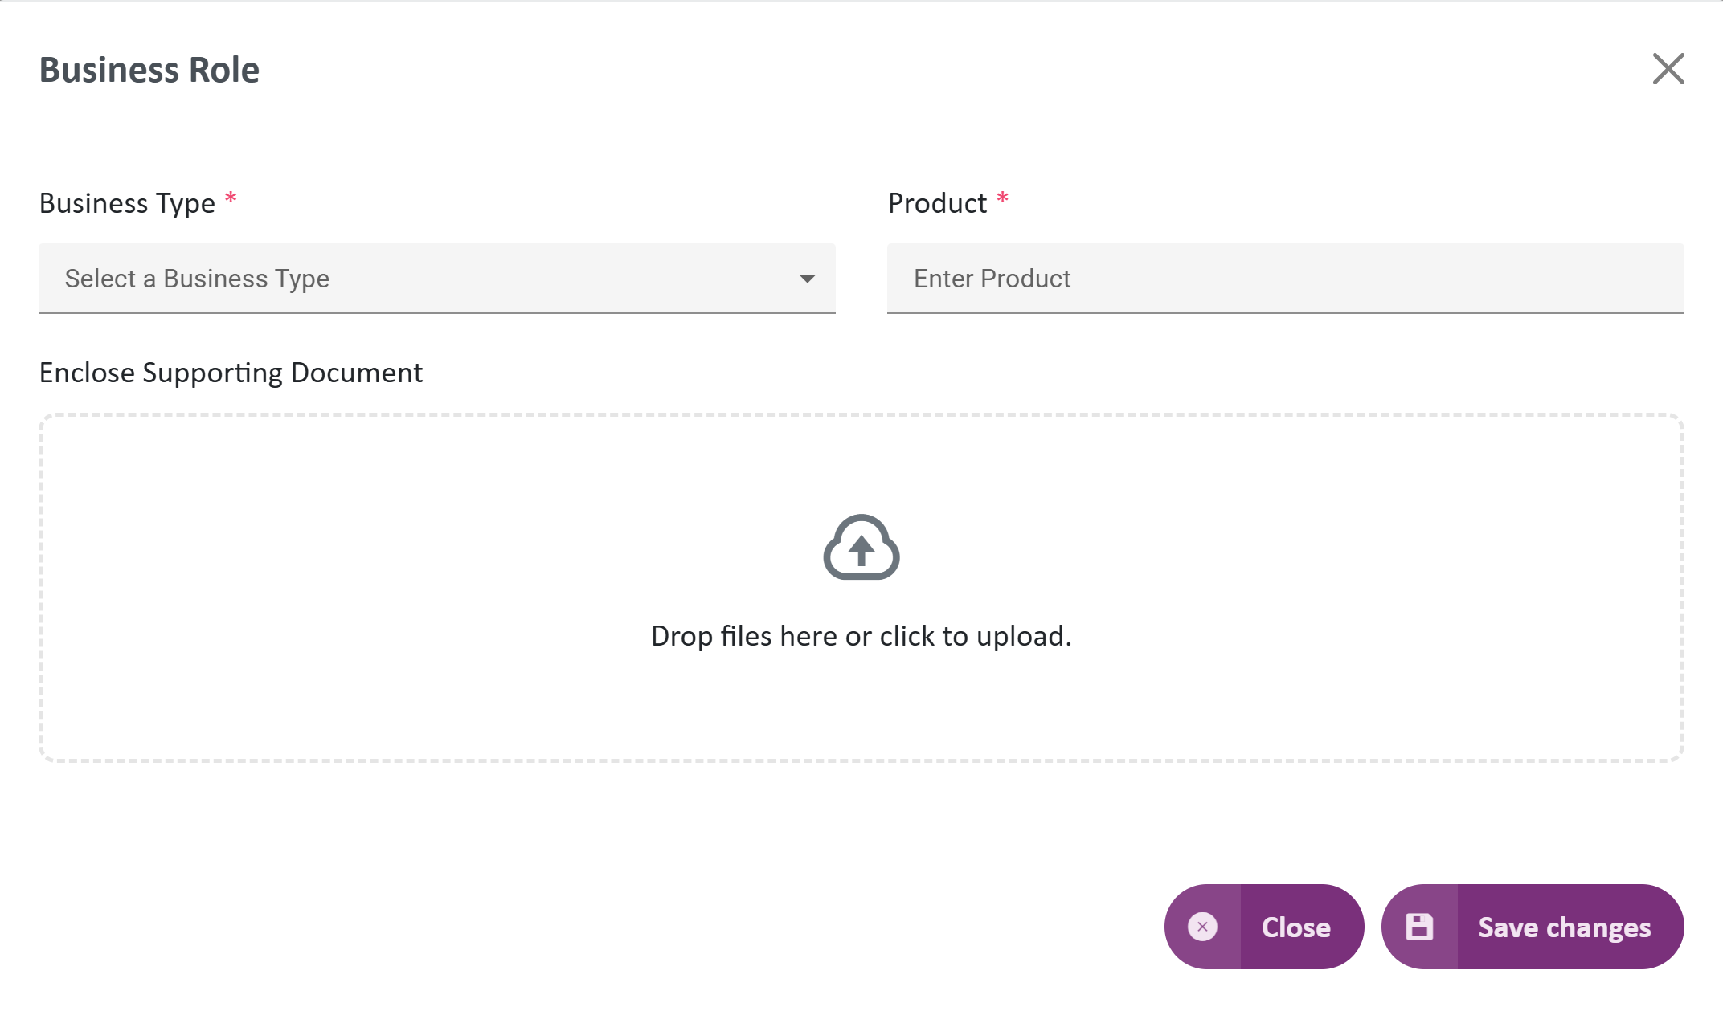
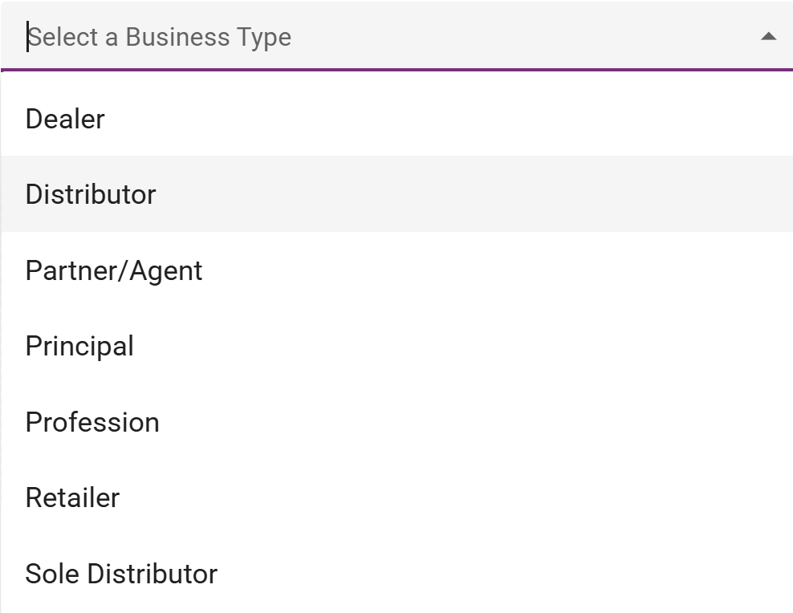
Complete Registration
Role
Mandatory filled, the purpose is to identify your company main product.
Business Information - Role
1
Click + to Add
Business Type - Select one of Business Type
If you are dealer, distributor, partner/agent or sole distributor, prepare certification or letter of appointment.
Principal also have letter of appointment from Brand Owner.
If you are Individual Entity, select profession and specify the profession.
If you are not all of that list, just select retailer.
2
FAQ
Can I have more than 1 Business Role ?

Slide 15
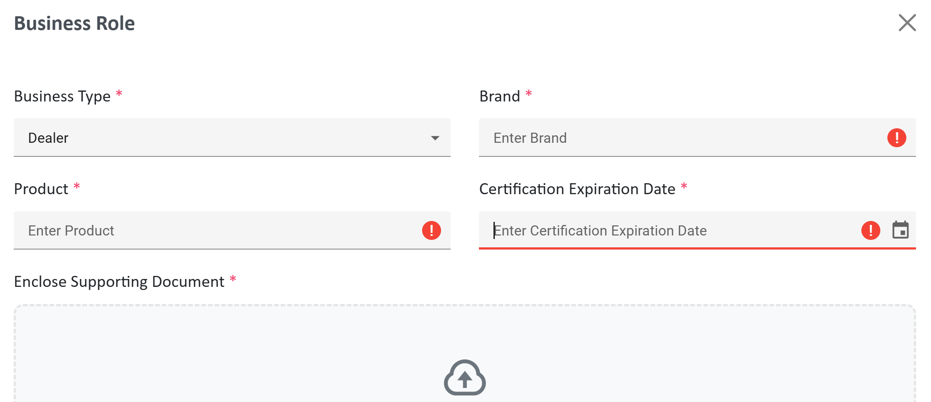
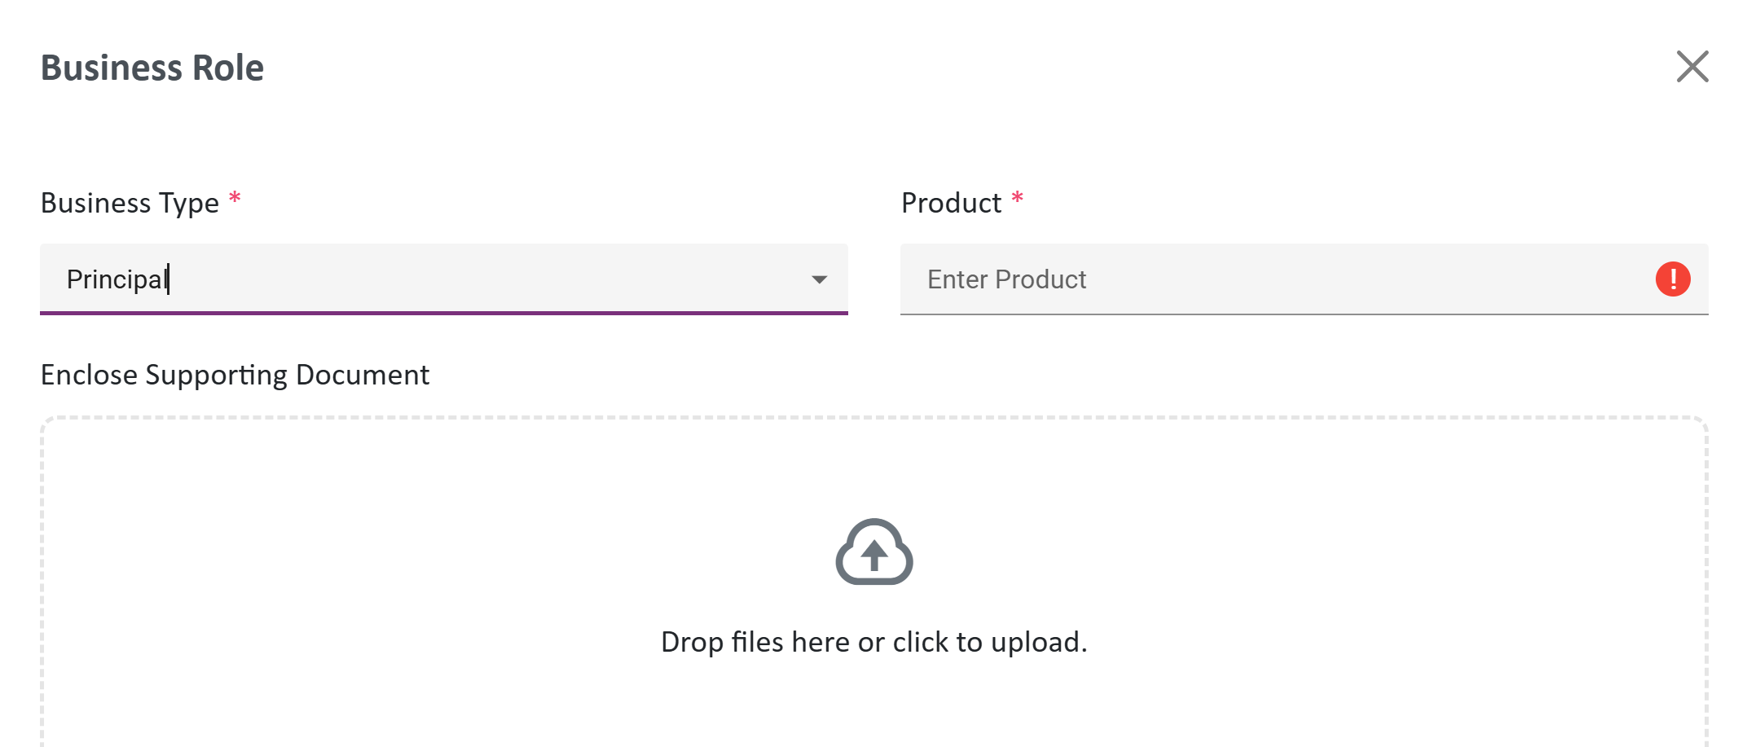
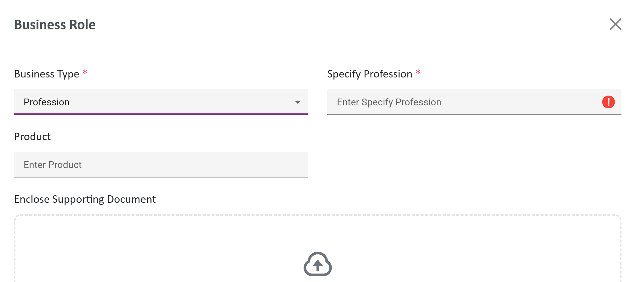
Complete Registration
Business Information - Role
C
Principal
Only state the product that has been appoint to your company.
A
Dealer, Distributor, Partner/Agent or Sole Distributor
Brand, Product, Certification Date are mandatory filled, the purpose is to identify your company main product.
B
D
Retailer
For Toko, Supermarket, any other company, just choose Retailer. Also Mandatory to fill product.
Profession need to specify the profession and optional for field product.

Slide 16
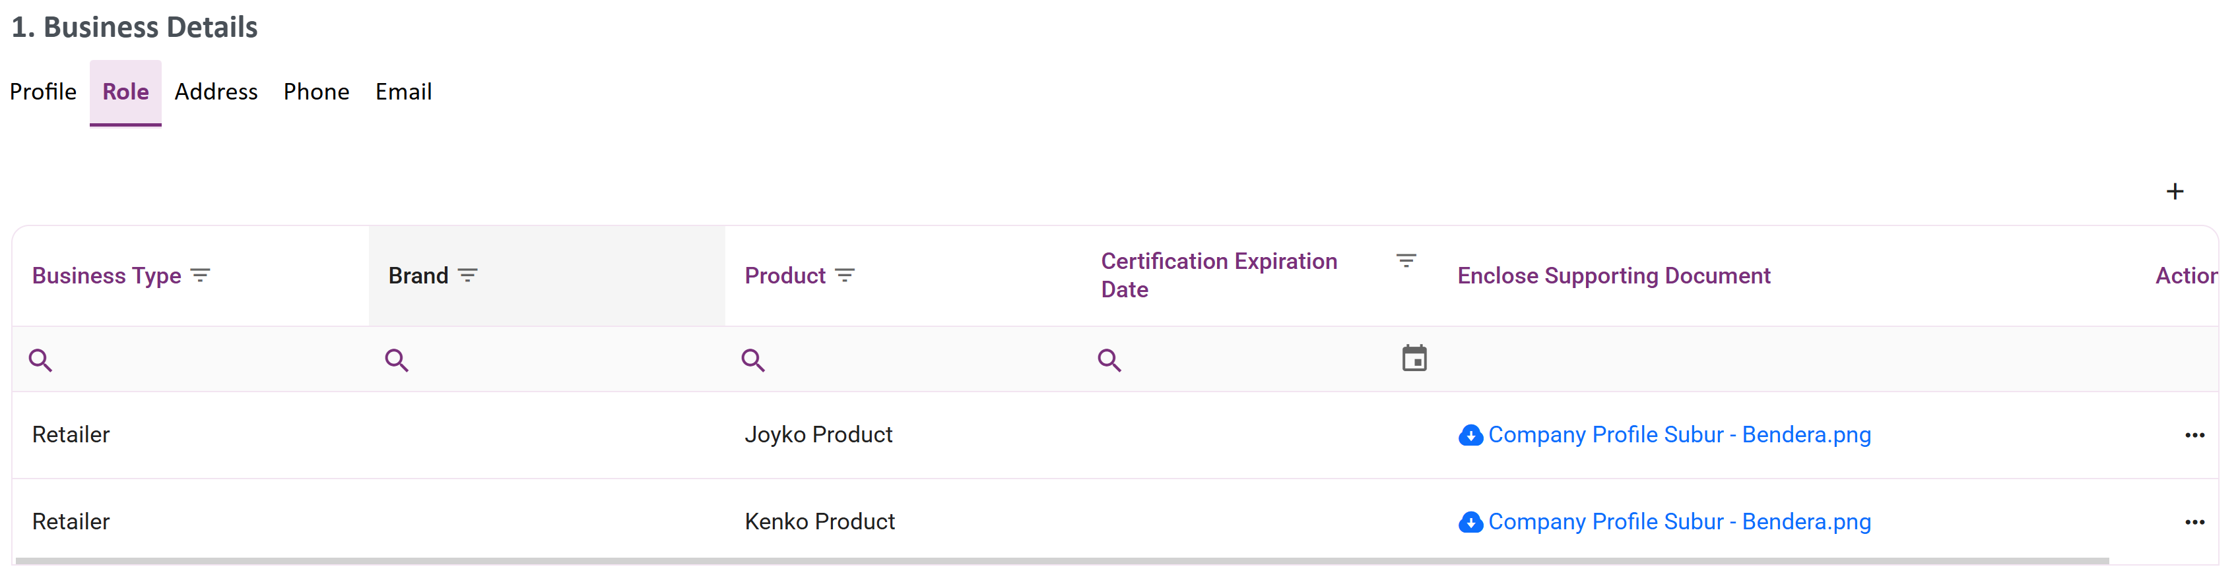

Complete Registration
Business Information - Role
You can add business type as needed

Slide 17
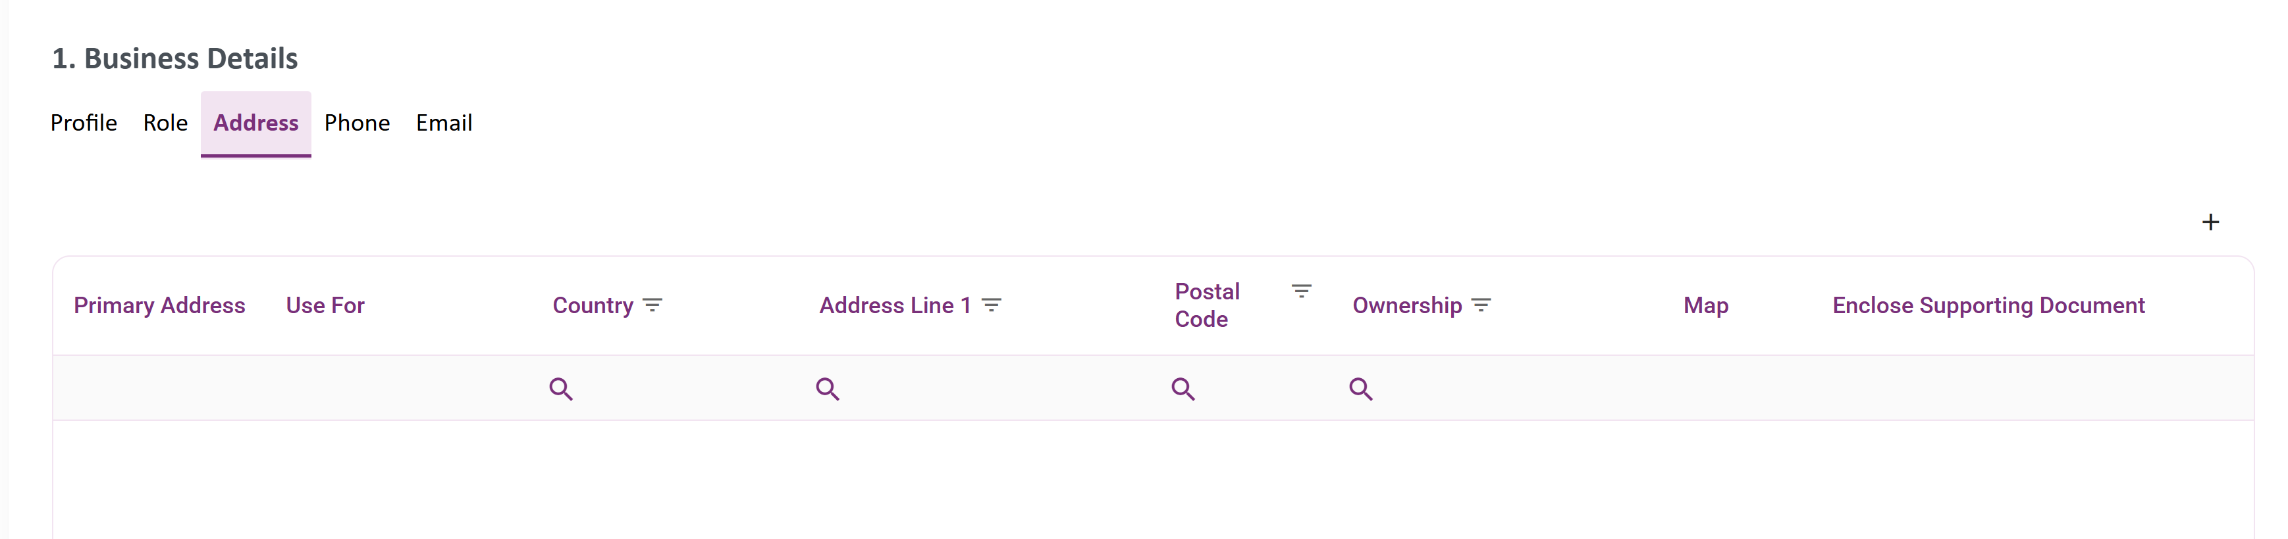
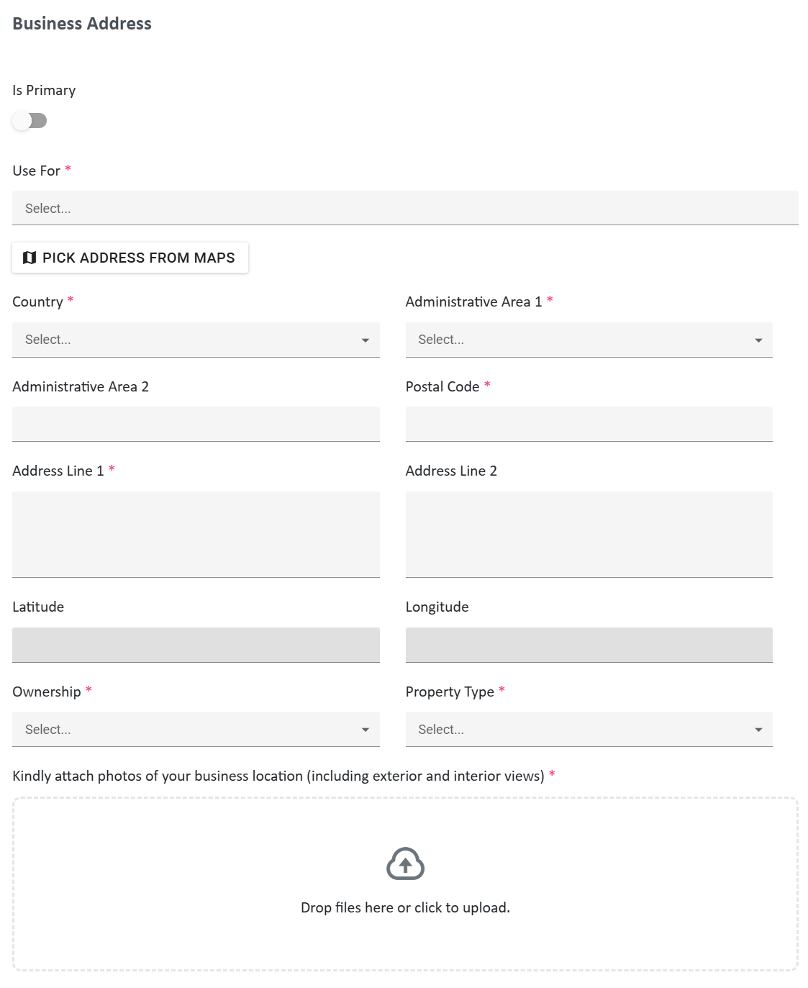
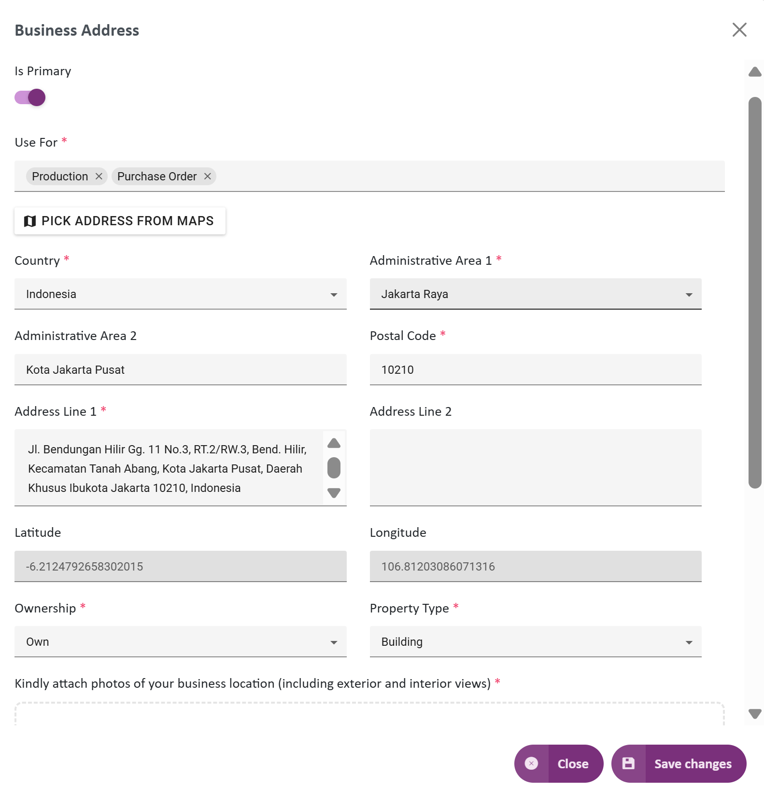
Complete Registration
Business Information - Address
1
Mandatory 1 address and you can add address as needed
Click + to Add

Slide 18
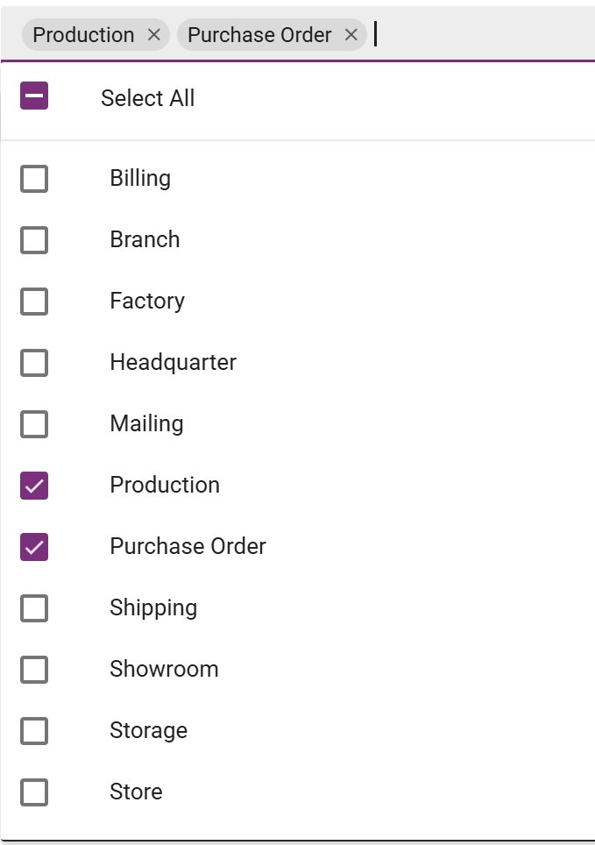
Complete Registration
Business Information - Address
Select Usage as needed,
At minimum you need to identify usage :
Billing
Mailing
Purchase Order
Shipping
1

Slide 19
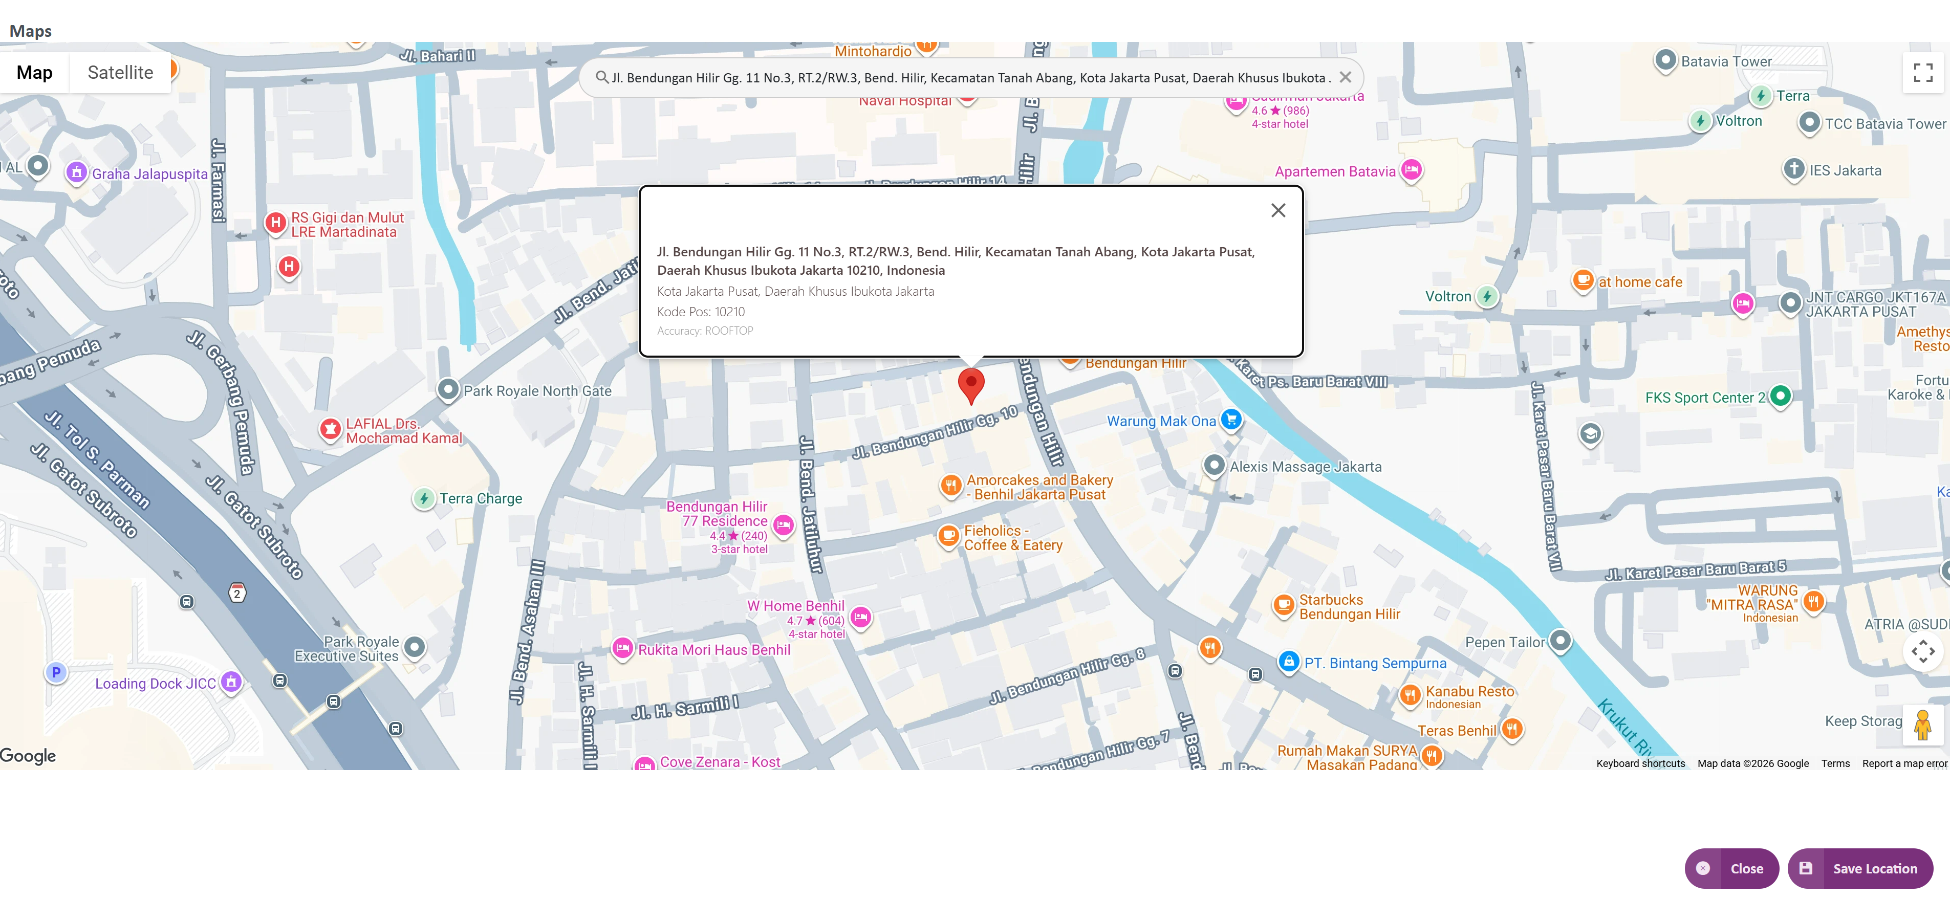
Complete Registration
Business Information - Address
Pin Point Maps
If needed, you can pin point the address on Maps
2
Click Save Location and Close

Slide 20
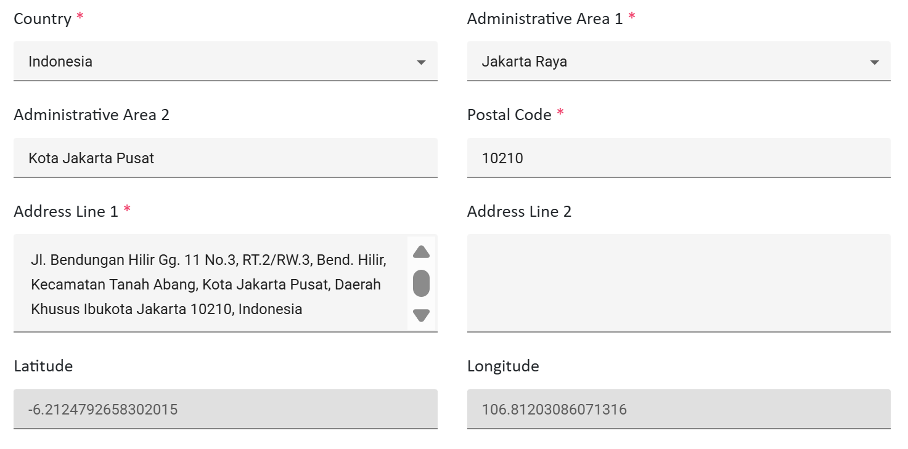

Complete Registration
Business Information - Address
3
Country
Select one country, country list show base on list in our system.
4
Administrative Area 1
Automatically show drop down list, if the country has the list of administrative area.
Administrative Area 1 as equal as Province, Prefecture, etc.
If not show drop down list, you can type free text on this field.
5
Administrative Area 2
Free text
If you Pick from Maps, some fields will be automatically filled
6
Postal Code
Postal Code of your address area
7
Address Line 1
Details of your address, you can define Street, District, Block, etc.

Slide 21
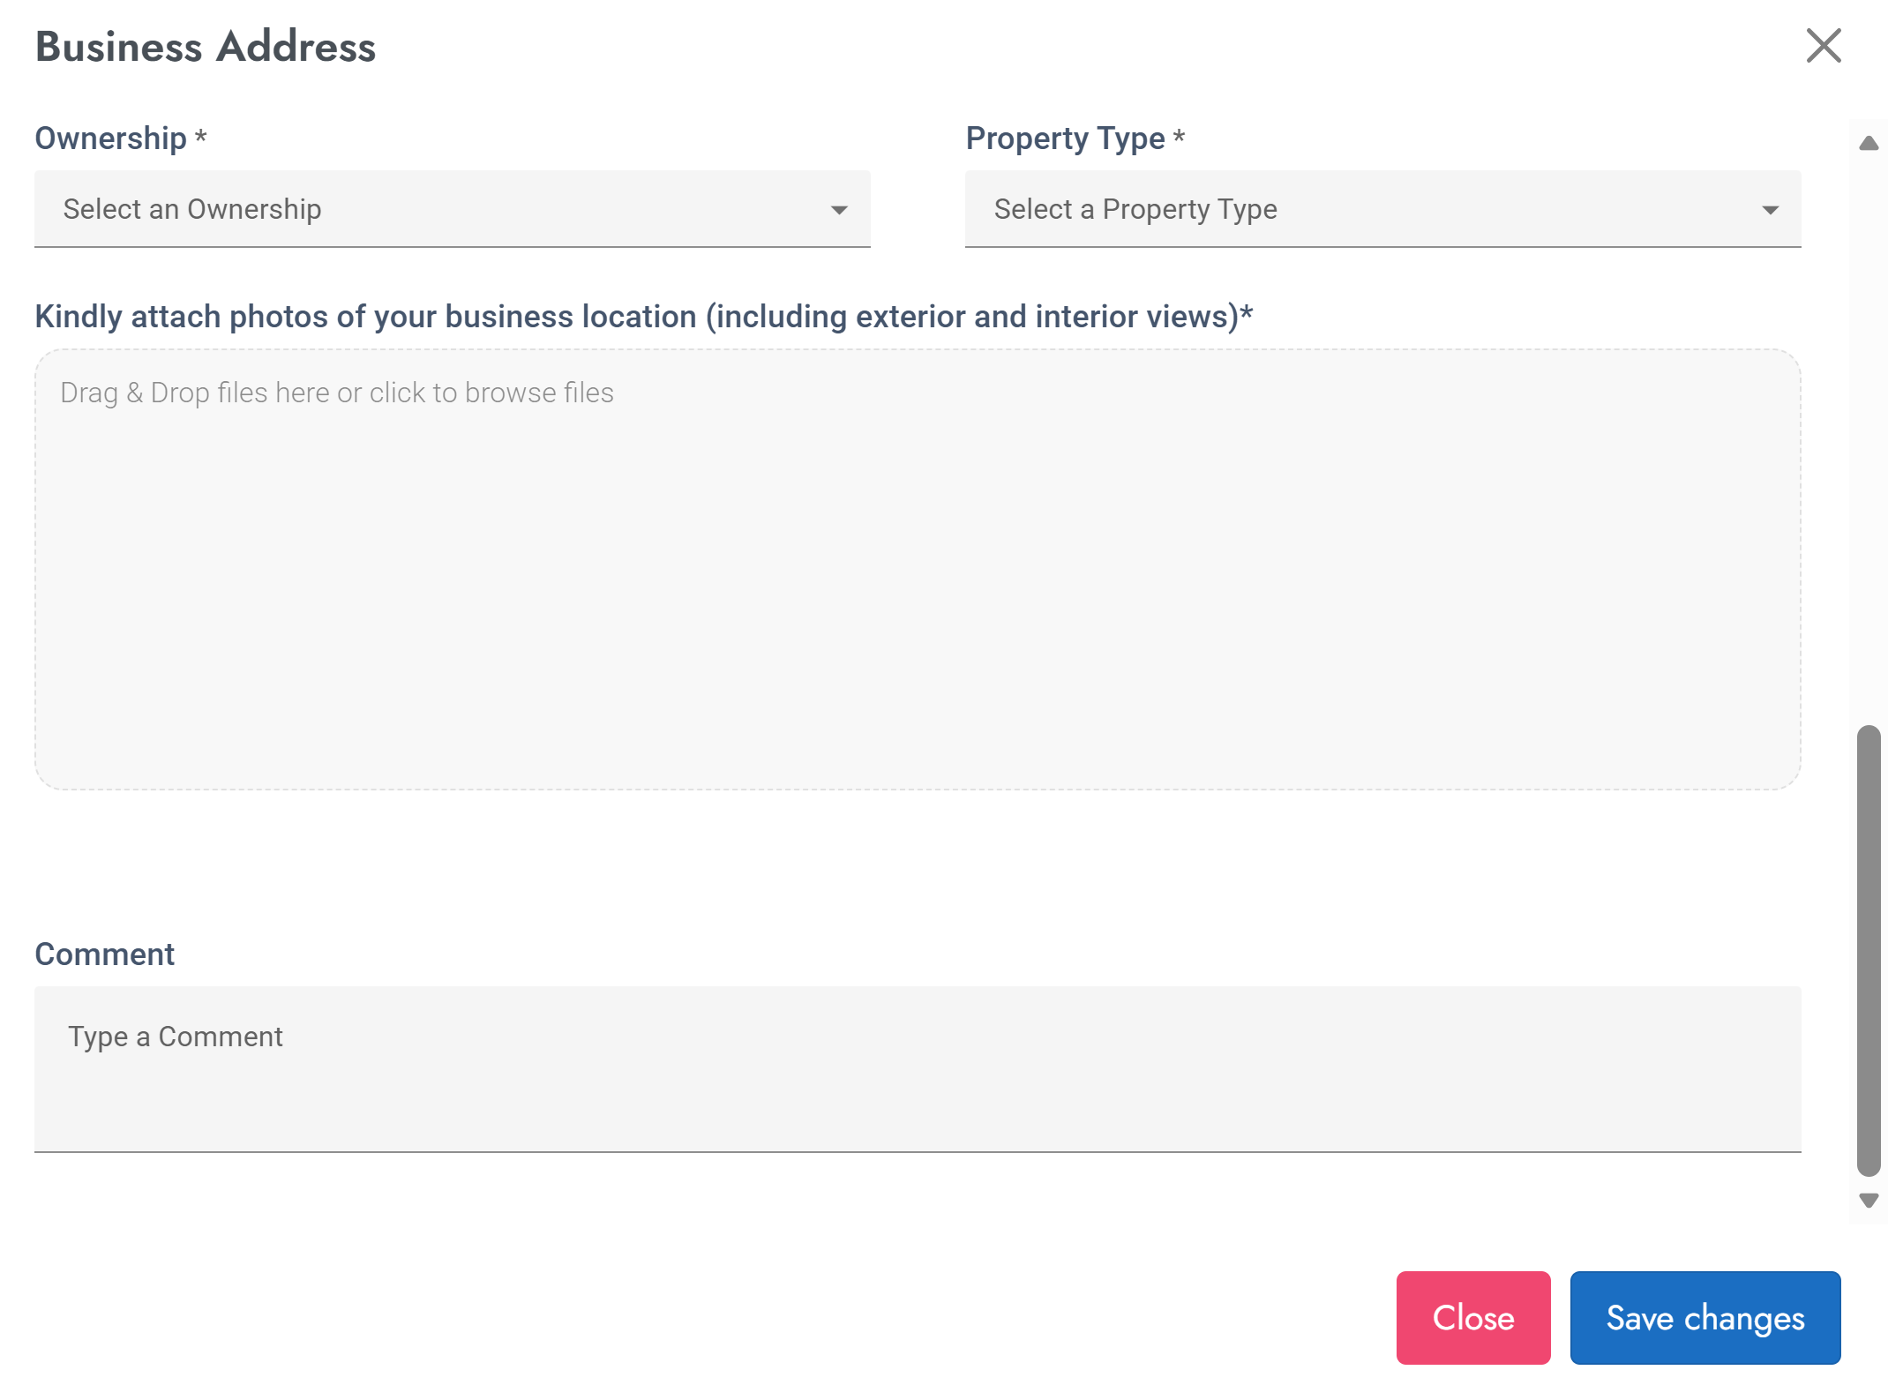
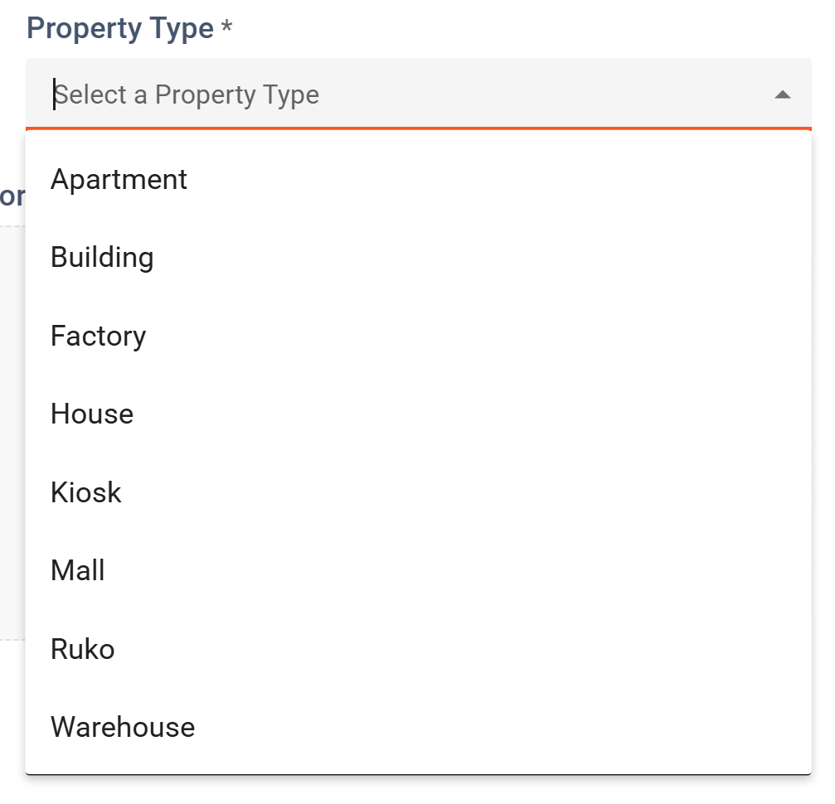
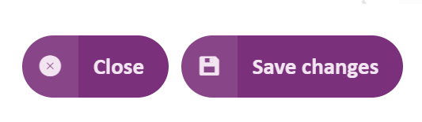
Complete Registration
Business Information - Address
8
Ownership
Own if you are the owner of the property
Lease if you rent the property
And Co-Working Space if you share working space with any other company.
Property Type
Select one from the list
9
10
Attachment
Attach photo of business location with slightly hints of business activity.
Click Save Changes and Close
11
Comment
Put comment related on that address

Slide 22
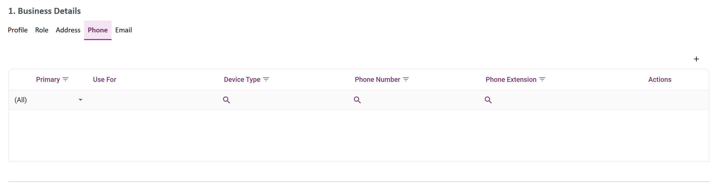
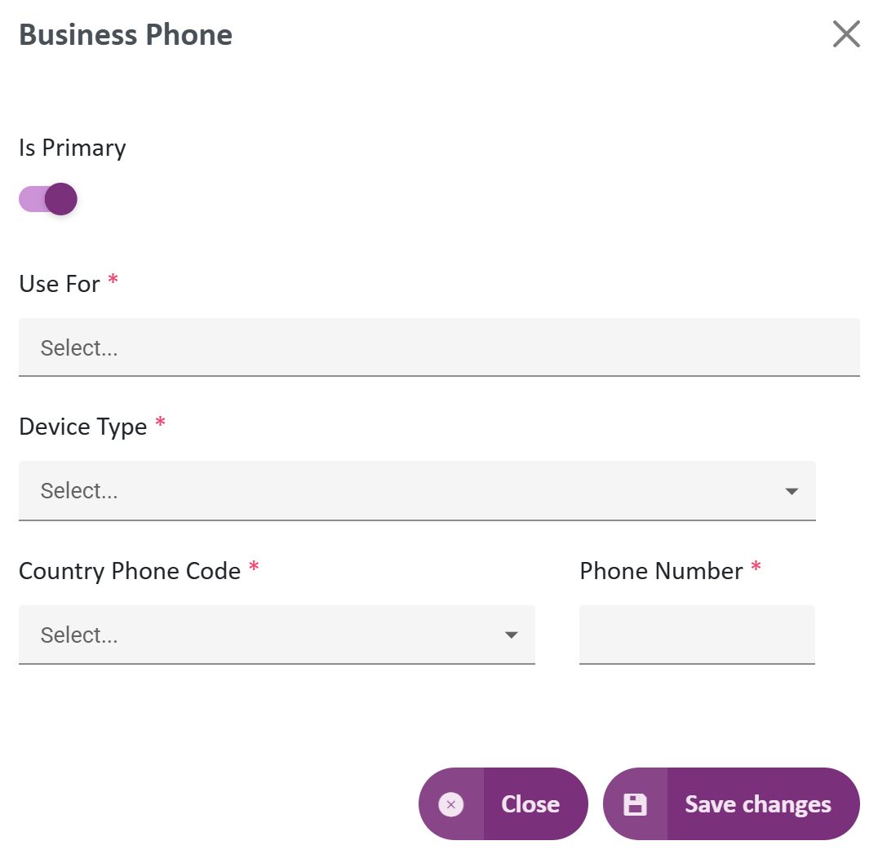
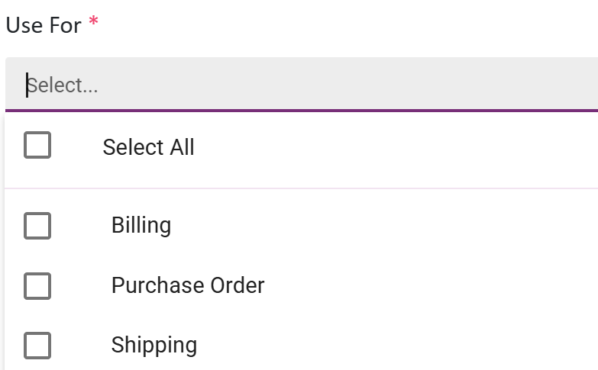
Complete Registration
Business Information - Phone
Must fill at least 1 Primary Phone
1
Click + to Add
2
Select Usage
Billing = Bill usage
Purchase Order = PO confirmation
Shipping = Ship contact
3
Device Type
Can be Office Phone, Mobile or Home Phone
Country Phone Code
Select from list
4
5
Fill with Phone Number
Extension
Only show if you choose Office Phone
6
Click Save Changes and Close

Slide 23
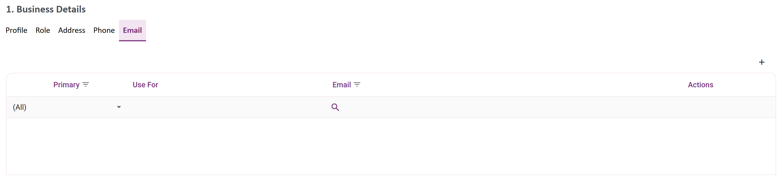
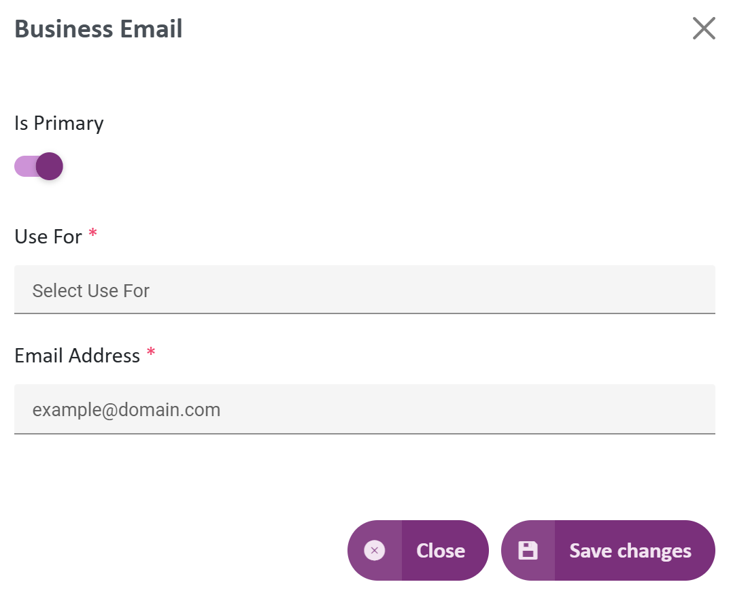
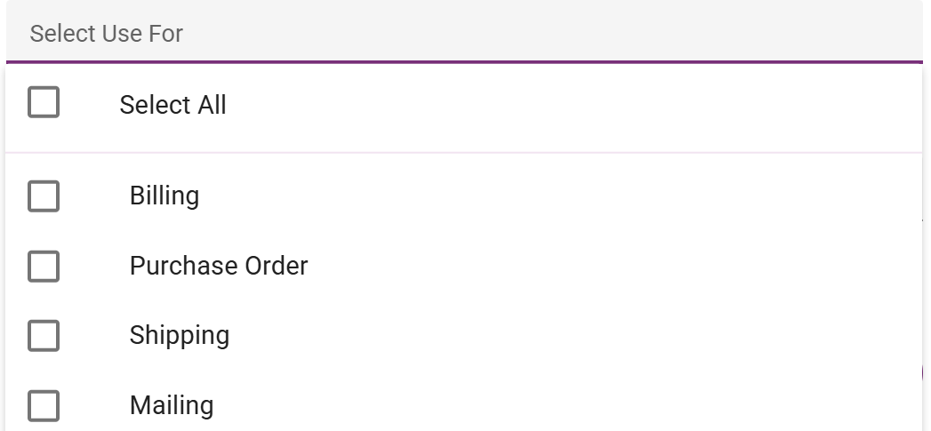
Complete Registration
Business Information - Email
Must fill at least 1 Primary Phone
1
Click + to Add
2
Email Address
Must follow format user@yyy.zzz
Use For
Select from list
3
Click Save Changes and Close

Slide 24
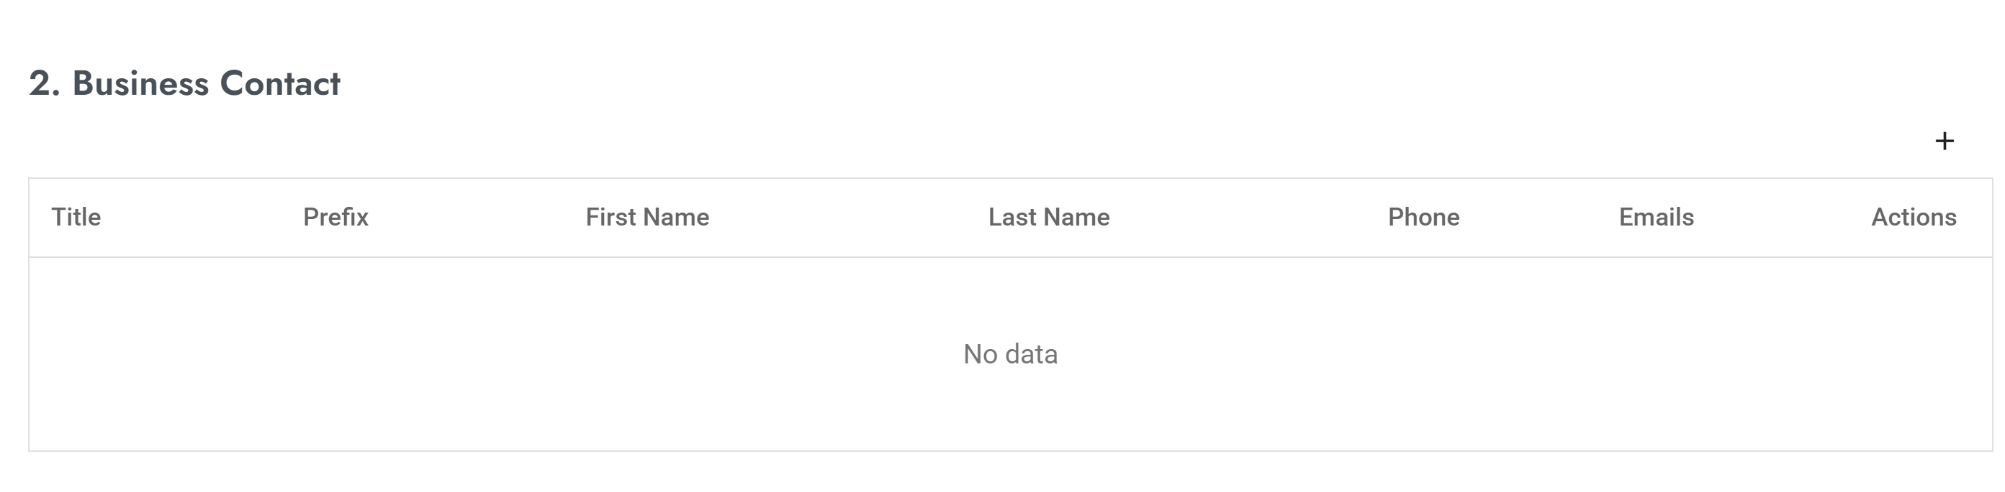
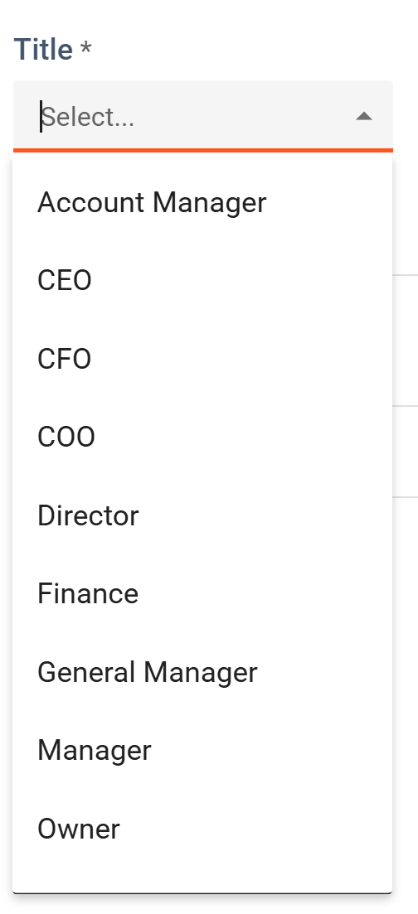
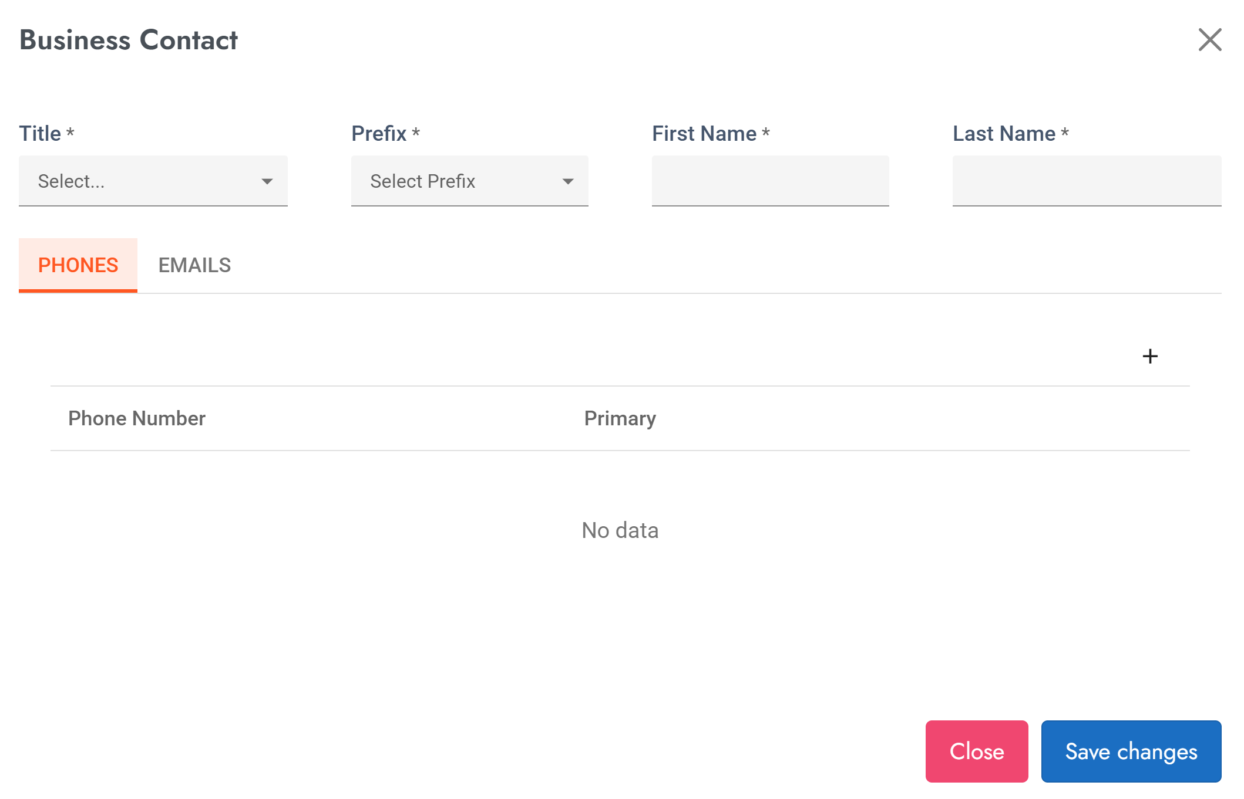
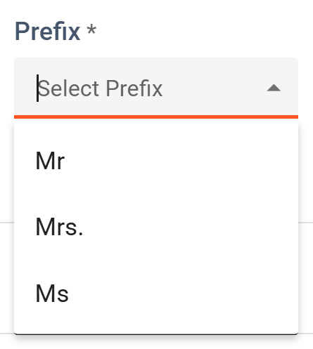
Complete Registration
Business Information – Business Contact
Must fill min 1 Contact Person
Title
Select position of Contact Person
1
Click + to Add
2
3
Prefix
Select from list
First Name and Last Name
Fill with Contact Person’s name

Slide 25
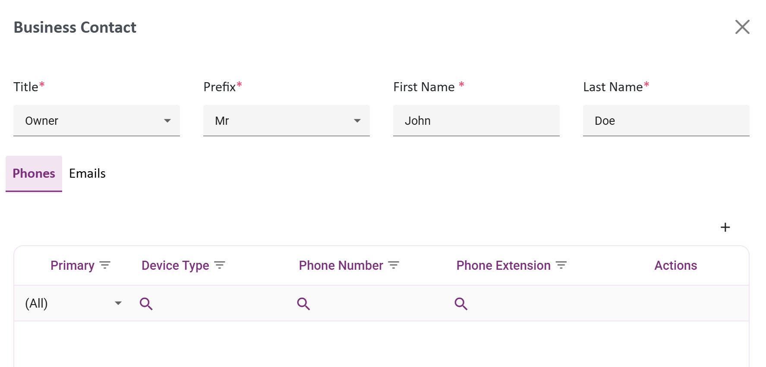
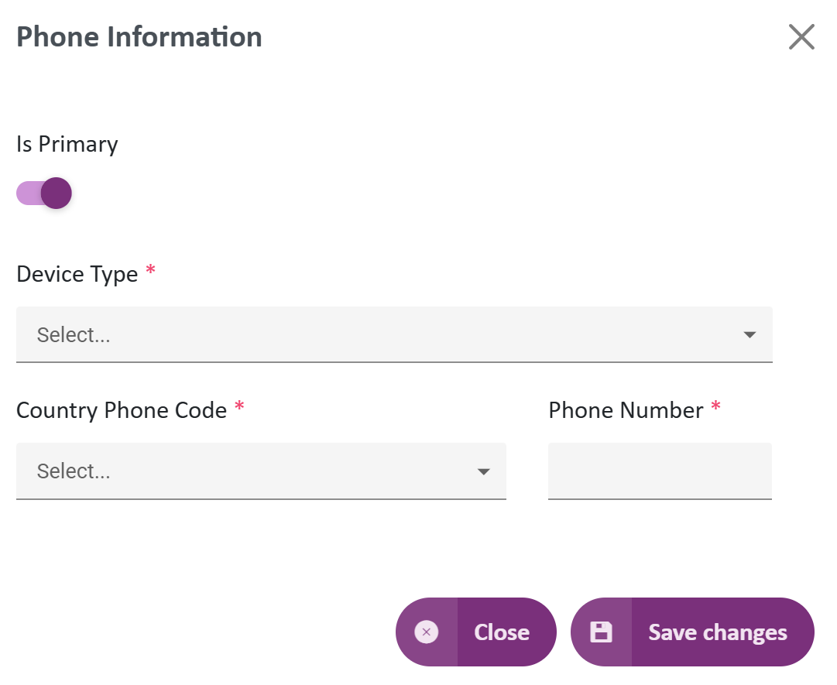
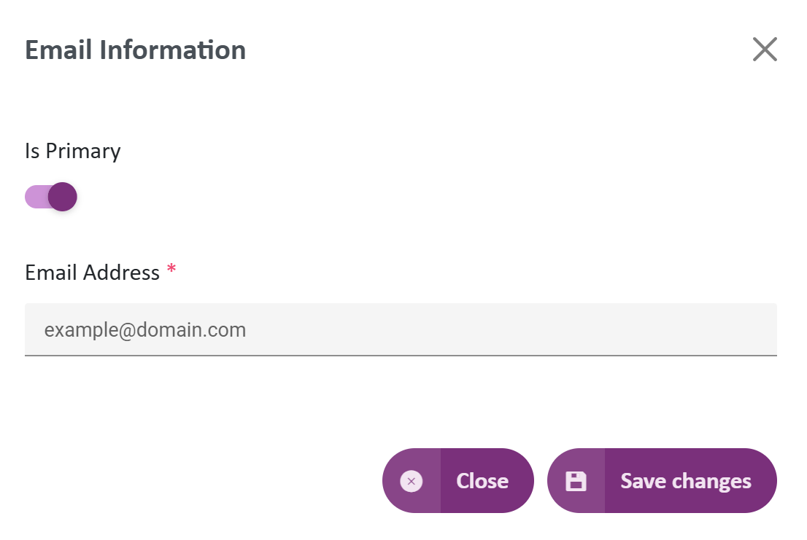
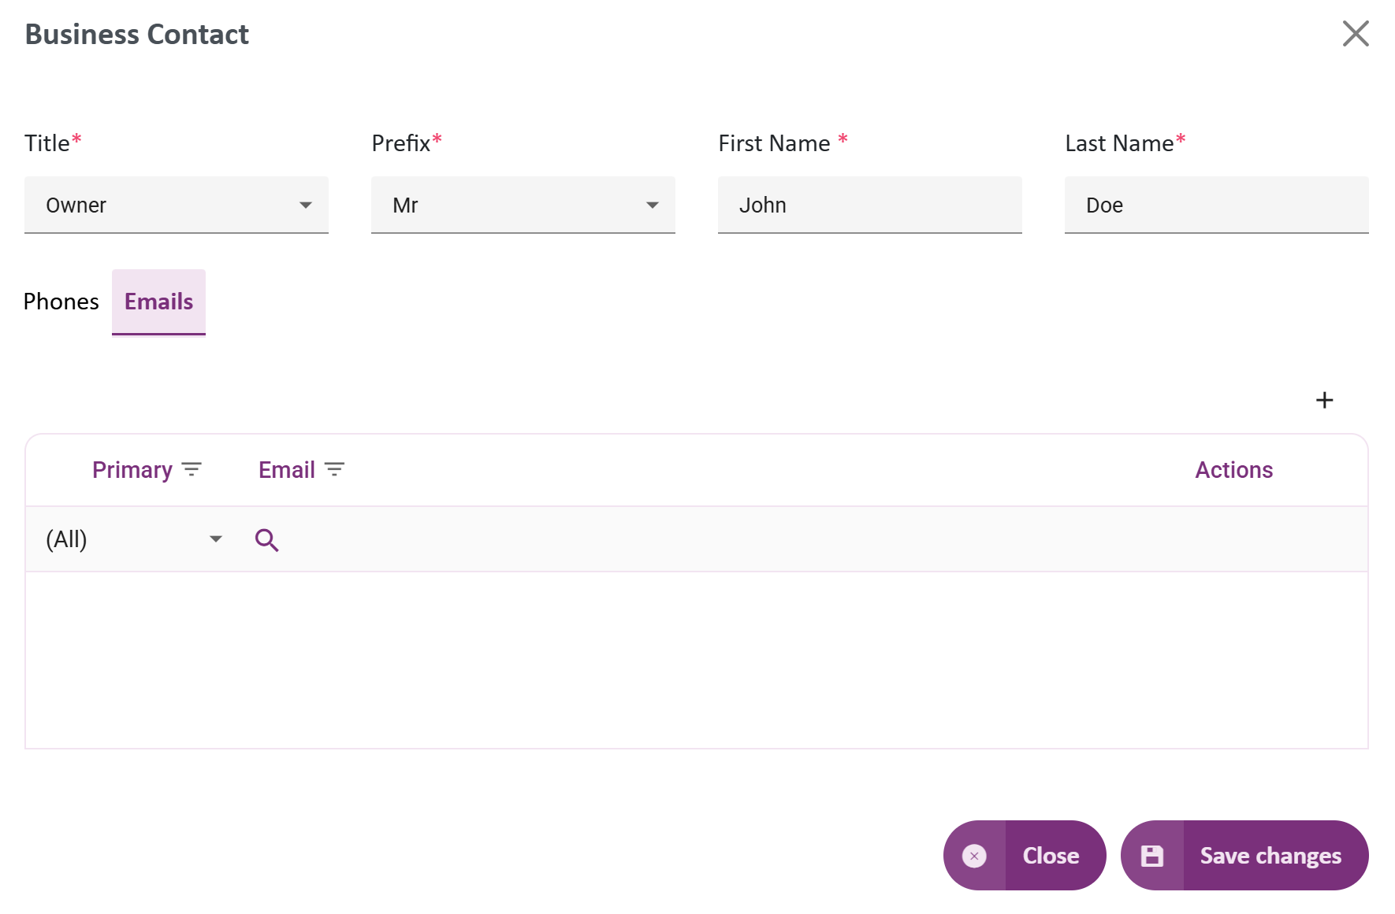
Complete Registration
Business Information – Business Contact
Phone Information
Please also fill phone information of Contact Person.
You can add more than 1 phone number.
1
Click + to Add
Email Information
Please also fill email information of Contact Person.
You can add more than 1 email.
Click + to Add
2
Click Save Changes and Close

Slide 26
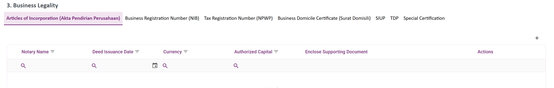

Complete Registration
Business Information – Business Legality
All Legality will be shown base on type or business - (Corporate / Individual / Web-Based)
If Corporate :
This 3 legality documents is mandatory
Articles of incorporation / Akta is needed for identify your establishment of your company
Business Registration Number is also know as Employer Identification Number or Unique Entity Number. This is mandatory
Tax Registration Number is mandatory, if your tax reporting country is Indonesia then you have to fill Business Location Identification Number or NITKU.

Slide 27
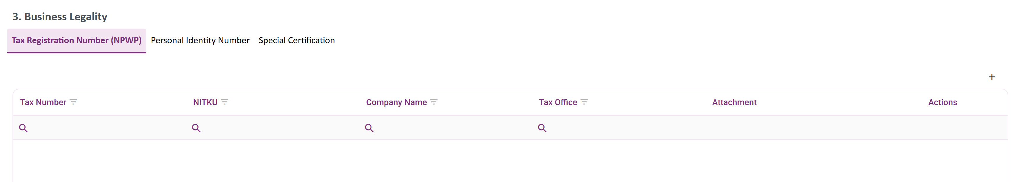

Complete Registration
Business Information – Business Legality
If Individual :
If your business is a micro business like “Toko”, Business Legality will show like individual.
If Web-based :
Website, is only used for business that only operate the sales via web. Example Canva Subscriptions.

Slide 28

Complete Registration
Business Information – Business Legality
Articles of Registration
1
Notary Name can be filled with freetext based on the name of notary.
Deed Issuance Date is official issued date of articles, and must be past date.
Currency & Authorized Capital is initial capital base stated on Articles.
Supporting Document = Articles
Shareholder Name fill with name stated on Articles. You need to add minimum 1 Shareholder Name and can add multiple names.
2
3
4
5
Click + to Add Shareholder Name

Slide 29



Complete Registration
Business Information – Business Legality
Business Registration Number (NIB)
Tax Registration Number (NPWP)
Tax Number for Indonesian Companies / Individual and must be contain 16 digit number.
*individual can attach Personal Identity Number (KTP)
for other country can be combination text and number.
Business Unit Tax (NITKU) also mandatory for Indonesian Companies and must be contain 22 digit number.
Issuance Date must be on the past / backdated.
Supporting Document = Business Registration Number / NIB letter.
Company Name usually same as Legal Business Name.
Tax Office (Kantor Pajak) Name filled with organization issued the tax registration number.

Slide 30



Complete Registration
Business Information – Business Legality
Business Domicile Certificate (Surat Domisili), SIUP and TDP
These all supported document needed. For SIUP and TDP, you cannot put expired letter.

Slide 31


Complete Registration
Business Information – Business Legality
Special Certification
Personal Identity
Needed for individual type of Supplier with profession, example : certified safety consultant, please upload certification of that profession.
For Company, you can upload certification as a company.
Mandatory for Individual type of business.

Slide 32



Complete Registration
Business Information – Business Stakeholder
Major Supplier
Major Supplier is not mandatory, but if you click add, then you have to complete the information of Contact Person. This information is to make sure that Supplier has good, trusted, and proven reputation.
1
Click + to Add
3
Click + to Add Contact Person
2
Fill with information with your 1 of Major Supplier

Slide 33

Complete Registration
Business Information – Business Stakeholder
Major Supplier
If you add major supplier, the table will summarize :
Can be expand and collapse

Slide 34



Complete Registration
Business Information – Business Stakeholder
Major Customer
Major Customer is not mandatory, but if you click add, then you have to complete the information of Contact Person. This information is to make sure that Supplier has good, trusted, and proven reputation.
1
Click + to Add
3
Click + to Add Contact Person
2
Fill with information with your 1 of Major Customer

Slide 35

Complete Registration
Business Information – Business Stakeholder
Major Customer
If you add major customer, the table will summarize :
Can be expand and collapse

Slide 36

Complete Registration
Business Information – Payment Terms
Payment Terms
Fill with default payment terms regulation on your Company
Choose payment terms from list

Slide 37


Complete Registration
Financial Information - Banking
1
Click + to Add
2
Is Primary?
Your first entry of bank account number is automatically flag as primary. You can change it later if you add another bank account number.
3
Country
Select one country, country list show base on list on our system
4
Beneficiary Account Information
Name : Base on bank account name
Number : Base on bank account number
Bank : Bank of the account
*if you cannot found Bank provider, please choose Country Burkina Faso and fill Bank Name with free text
5
Currency accepted

Slide 38




Complete Registration
Financial Information - Banking
If Beneficiary Account Number is not exist, you will get error message.
If Beneficiary Account Name is different with Legal Business Name, you have to attach statement letter. Automatically detect.
1
2
Download at link statement letter
Complete form
Sign and Stamp the letter
Attach again
*sign by finance director / owner or equal
Upload and Save
3

Slide 39

Complete Registration
Financial Information - Banking
You can add more than 1 banking information as needed

Slide 40

Complete Registration
Financial Information - Financial
Financial
Financial segment is a list of questions related your company financial insight.
Please complete all of questions.
Financial Statement
If company doesn’t have financial statement report, please tick no. On contrary, please tick yes.

Slide 41


Complete Registration
Financial Information - Financial
Financial Statement 1/2
Financial segment is a list of questions related your company financial insight.
Please complete all of questions.
1
If you tick Yes, there are additional questions that need to be filled.
2
State one of the statements you have
3
Fill with latest year statement
4
Currency accepted

Slide 42

Complete Registration
Financial Information - Financial
Financial Statement 2/2
Financial segment is a list of questions related your company financial insight.
Please complete all of questions.
4
If you tick Yes, there are additional questions that need to be filled.
Not all company has been audited, answer this question based on your company experience.
5
6
State of the Accounting firm that perform audit to your company
Fill with audit result
7
8
Upload Audit Result Document

Slide 43

Complete Registration
Financial Information - Financial
Financial Performance
This financial insight is mandatory to be filled.
You can always state estimated amount if you don’t exact amount or financial statement.

Slide 44




Complete Registration
Financial Information - Financial
Liquidity & Payment
If you tick Yes, there are additional questions that need to be filled.
1
2
3
Debt is identified as 3 range of terms
Current : On Time, tidak ada tunggakan
Delayed : Slightly Late, tidak ada tunggakan
Defaulted : Payment severely late

Slide 45


Complete Registration
Financial Information - Financial
Tax & Legal
Compliance Status of Tax
1

Slide 46

Complete Registration
Financial Information - Financial
Feasibility & Sustainability
If you tick Yes, there are additional questions that need to be filled.
1
Compliance Status of Tax
1

Slide 47


Complete Registration
Financial Information - Financial
Relationships & Reputation

Slide 48





Complete Registration
Questionnaire
Please state if you are part of Group / Holding
1
If yes, (you have affiliation company such as sister company, joint company, etc.) please fill more detail
2
3
Click + to Add
4
Fill with your affiliated company

Slide 49





Complete Registration
Questionnaire
1
Please state if you have affiliation with BINUS
2
Click + to Add
3
Your company side
4
BINUS Side

Slide 50


Complete Registration
Questionnaire
1
BINUS Alumnus, if owner of the company is alumnus
2
Complete the details
3

Slide 51


Complete Registration
Questionnaire
Project References
Add Project References for information
Click + to Add
1
Project References is optional, but this is a good information to show Supplier achievement and experience.
Complete the details
2
Save Changes
3

Slide 52

Complete Registration
Questionnaire
Please fill all of this question.

Slide 53

Complete Registration
Declaration
Declaration is our Integrity Pact
You have to agree to integrity pact
Read it and check as a sign that you have read
This declaration also have to be sign by min level director or equal
4
Currency accepted

Slide 54


Complete Registration
Declaration
1
Download Form, Complete and Sign
2
Upload again to this field
3
Check Agree
4
Signature Name (director or equal)

Slide 55


Complete Registration
Click Submit
to sent the registration application to Internal BINUS
Whatever the action is
You can track your Registration Status at Homepage.
At any time, you can Click Save as Draft
You can continue your registration later by Click View My Registration
At any time, you can Cancel
Cancelling form will make the form need to be filled again
4
Currency accepted

Slide 56


Track My Registration
Whatever the action is
You can track your Registration Status at Homepage and you can Check Process History
4
Currency accepted

Slide 57


FAQ
Is it okay to complete registration later ?
What if you forget your password ?
Is it okay to complete registration later?
What if you forget your password ?
Click Forget password and follow instruction to reset your password. later
Yes, you can always complete the registration later. Check your homepage. At registration status, click View My Registration.
What should I prepared before register ?
What should I prepared before register?
Please prepare legality document such as Tax Regist Number, Business Identity Number, Company Profile, Working Location Photo, Lease / Rent Letter for location, etc.
What if I had failed to input OTP ?
What if I had failed to input OTP ?
You only have 5 chances to input OTP or you can Resend OTP.
Can I have more than 1 Business Role ?
Yes, your company can have more than 1 Business Role. For example, company may act as a distributor for Product A, an exclusive distributor for Product B, and a retailer for Product C.

Slide 58
Thankyou
4
Currency accepted

